Slide 1
Turn in Atomic War Worksheets, Get out Symbol Story
Agenda
AQOD
Go over Symbol Story
History of Atomic Model Presentations
Discussion/Additional Information
Study for Quiz tomorrow
How many neutrons does Potassium-40 have?

Slide 2
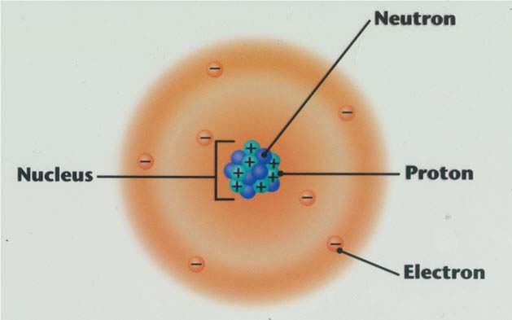
The Story of the Atom

Slide 3
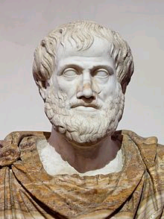
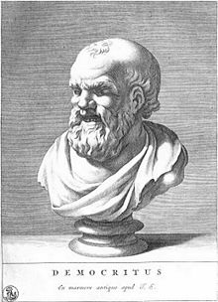
Early Greek Theories (400 BC)
Democritus
Aristotle
Though matter could not be divided indefinitely
Decided there must be something that can’t be cut – called an “atom”
Said all things are made of “elements” of earth, wind, fire, and water
Wrong, but his theory persisted
Notes:
Democritus
Democritus, a Greek philosopher, imagined continually cutting something like bread in half.
He thought that eventually we would end up with a particle that could not be cut, which he called the atom.
He thought that everything was made of atoms that came in different shapes and sizes.
Aristotle
However, Aristotle was another Greek philosopher and he disagreed.
He said that the elements were earth, wind, fire, and water.
This idea continued for thousands of years! (Some of you even said that those were the elements at the beginning of the year!)
NOS: Socio-cultural embeddedness
We’ve all heard of Aristotle, so what he said continued (he was more well-known and had more support)
NOS: the Empirical Basis of Scientific Knowledge
Even though now we know that most of what Democritus thought was correct, he didn’t really have any evidence, just his imagination, for atoms. So Aristotle’s idea continued.

Slide 4
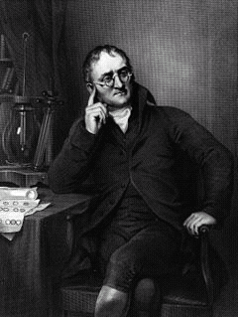
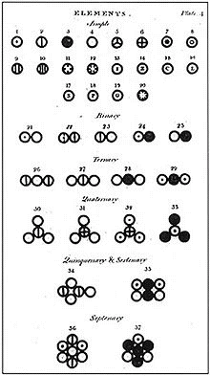
1800 - John Dalton
Suggested elements are made of single atoms
Came up with his atomic theory – all substances are made of atoms
Based on experiments, not just reasoning
http://web.visionlearning.com/dalton_playhouse/ad_loader.html
Notes:
John Dalton
By the 1700s, scientists knew that elements combine in certain proportions based on mass
Dalton wanted to know why this occurred. He suggested elements were made of single atoms
In 1803, Dalton published his atomic theory.
All substances are made of atoms which can’t be created, divided, or destroyed.
Atoms of the same element are alike and atoms of different elements are different.
Atoms join together with other atoms to make new substances
The website link is for “Dalton’s Playhouse” which is an interactive website where students can “redo” experiments that led Dalton to come up with his atomic theory
Can do if time
NOS: Nature of a theory
Dalton’s atomic theory is a theory because it attempts to explain something that happens in nature. He had evidence to support his theory, but atomic theory has continued to evolve over time.
NOS: Tentativeness of scientific knowledge
Dalton wasn’t completely correct (idea that atoms can’t be divided and that atoms of the same element are exactly alike). Even though he came up with a theory, which we know is a big deal in science, it was still tentative and developed further.

Slide 5
Dalton’s Atomic Theory
All matter is made of atoms
Atoms of an element are identical
Each element has different atoms
Atoms of different elements combine in constant ratios to form compounds
Atoms are rearranged in reactions
Ideas account for the law of conservation of mass (atoms and matter are neither created nor destroyed) and law of constant composition (elements combine in fixed ratios)

Slide 6
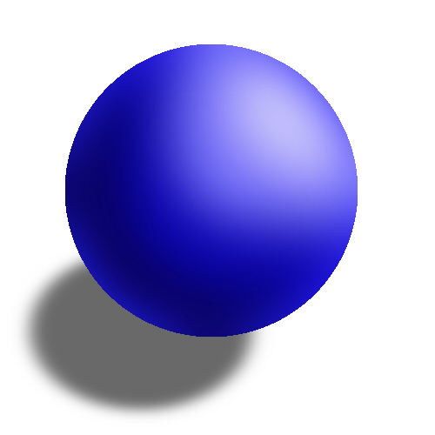
Dalton’s Model of the Atom (1800 – 1900)
Billiard Ball model
Atoms are solid and indivisible

Slide 7
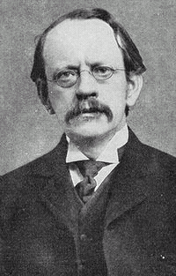
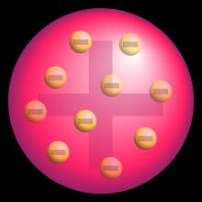
1897 - J. J. Thomson
Discovered electrons!
Because the cathrode ray (charged atoms) was attracted to the positive plate, that means atoms must have negative charges or electrons
Had a “plum pudding” (chocolate chip ice cream) model for atoms
Negative charges in an overall positive framework
Plum Pudding Model
Cathrode ray deflected by electric field
Notes:
J.J. Thomson (1897)
He was a British scientist who discovered that Dalton was wrong – there were particles inside the atom
Used a cathrode-ray tube experiment where a beam of bent when the passed through charged plates. The positively charged plate attracted the beam.
Thomson concluded that the beam was made of particles that had negative electric charges.
Discovered electron.
NOS: Tentativeness of scientific knowledge
J.J. Thomson came up with the “plum pudding” model of the atom. We know this model is wrong and our idea of what an atom looks like has developed. J.J. Thomson’s model was the most accurate he could make based on the evidence he had at the time.

Slide 8
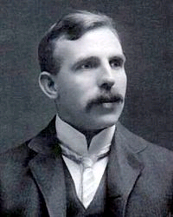
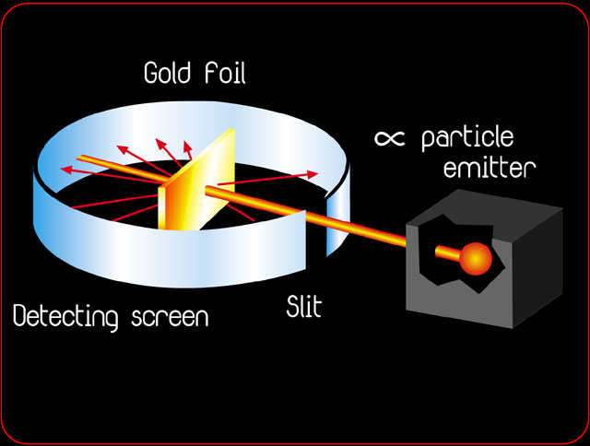
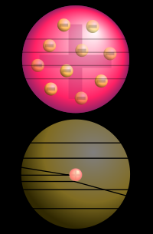
1911 - Ernest Rutherford
Experiment Set Up
Discovered the nucleus of atoms
Atoms are mostly empty space with a small positive nucleus that holds most of the atom’s mass
Expected Results
Actual Results
Notes:
Ernest Rutherford (1911)
He was a student of Thomson’s.
He (and his assistants) shot positively charged particles at a thin sheet of gold foil. (see picture)
Some of the particles bounced back – which he compared to:
“It was almost as if you fired a fifteen-inch shell into a piece of tissue paper and it came back and hit you.”
His results weren’t expected – if the atom was “plum pudding” the particles would have shot straight through. Instead, some curved (see picture)
Developed the idea of the nucleus
NOS: Creativity and Imagination
Rutherford’s results were surprising and took some imagination to interpret.
NOS: Empirical Basis of Scientific Knowledge
Rutherford’s results were not what was expected. As a result of empirical evidence, the atomic theory developed and changed.

Slide 9
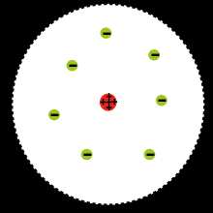
Rutherford’s Atomic Model
Atoms are mostly empty space
Small, positive nucleus

Slide 10
1913 - Niels Bohr
- Proposed electrons orbit the nucleus in “shells”
- Electrons can be bumped up to a higher shell if hit by electrons or light energy
- Electrons can jump from shell to shell

Slide 11
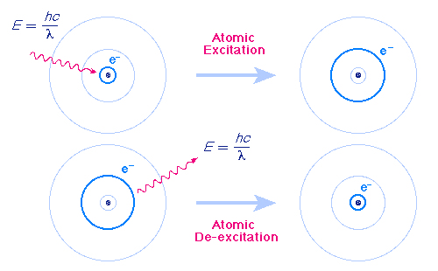
Bohr Atomic Model

Slide 12
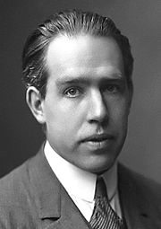
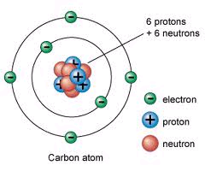
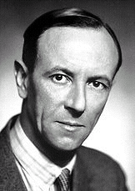
Furthering Rutherford’s Atom
Niels Bohr
James Chadwick (1922)
Proposed that electrons move around in certain paths
The nucleus of an atom contains neutrons
Notes:
Niels Bohr (1913)
Worked with Rutherford
Proposed that electrons move around in certain paths
Based this off the way atoms react to light
James Chadwick (1922)
Discovered the neutron – nucleus contains neutrons too (neutral particles)
NOS: Empirical Basis of Scientific Knowledge
As more evidence is obtained, the atomic theory develops (Also nature of theories and laws)

Slide 13
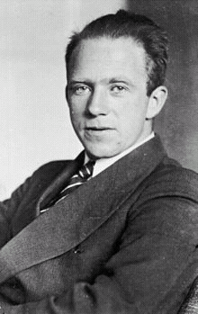
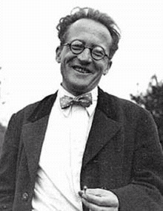
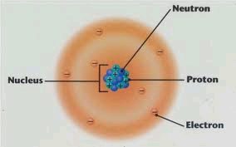
1926 – Electron Cloud Model
Erwin Schrödinger
Werner Heisenberg
Instead of set paths, electrons move around in electron clouds
Notes:
Erwin Shrodinger & Werner Heisenberg (1926)
Schrodinger – Austria, Heisenberg - German
Exact path of electron cannot be predicted
Instead, electrons move around in electron clouds (general areas)
NOS: Nature of Theories and Laws
The atomic theory developed as scientists gathered more evidence
NOS: Lack of Universal “Method” Employed by Scientists
It wasn’t just one scientist that came up with the atomic theory but a number. The theory developed as different scientists did different experiments. A lot of the experiment results, like Rutherford’s and Thomson’s were surprising.
NOS: Socio-cultural Embeddedness of Science
In the end, a large number of scientists from many different countries did research to help develop the atomic theory.

Slide 14
The Wave Model
In fact, it is impossible to determine the exact location of an electron. The probable location of an electron is based on how much energy the electron has.
According to the modern atomic model, at atom has a small positively charged nucleus surrounded by a large region in which there are enough electrons to make an atom neutral.

Slide 15
Electron Cloud:
A space in which electrons are likely to be found.
Electrons whirl about the nucleus billions of times in one second
Location of electrons depends upon how much energy the electron has.

Slide 16
Electron Cloud:
Depending on their energy they are locked into a certain area in the cloud.
Electrons with the lowest energy are found in the energy level closest to the nucleus
Electrons with the highest energy are found in the outermost energy levels, farther from the nucleus.

Slide 17
 | Indivisible | Electron | Nucleus | Orbit | Electron Cloud
Greek | X
Dalton | X
Thomson |  | X
Rutherford |  | X | X
Bohr |  | X | X | X
Wave |  | X | X |  | X

