Slide 2
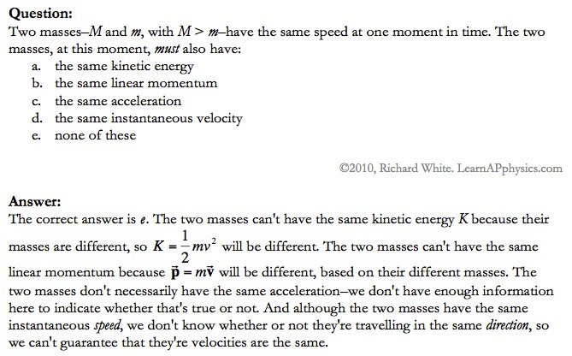

Slide 3
Plan for Today (AP Physics 2)
Go over AP Problems
Lecture/Notes on X-Rays, Compton Effect, and deBroglie
Ch 27 HW due Monday

Slide 4
AP Problems

Slide 5
X Rays

Slide 6
X Rays Background
1895 – Wilhelm Roentgen noticed a fluorescent screen glowed when it was several meters away from electric discharges of gases and even with cardboard in between
This must be some mysterious radiation
Called them x-rays
Traveled at the speed of light
Could not be deflected by electric or magnetic fields

Slide 7
X Rays Background
1912 – Max von Laue – x-rays are electromagnetic waves with short wavelengths
Then we should be able to diffract x rays using crystal lattice for diffraction grating
Use x-ray diffraction to study matter (spacing between atoms)

Slide 8
X Rays
Wavelengths are around 0.1 nm
Part of electromagnetic spectrum
Higher frequencies than UV
Can penetrate most materials
Produced when high-speed electrons are suddenly slowed down

Slide 10
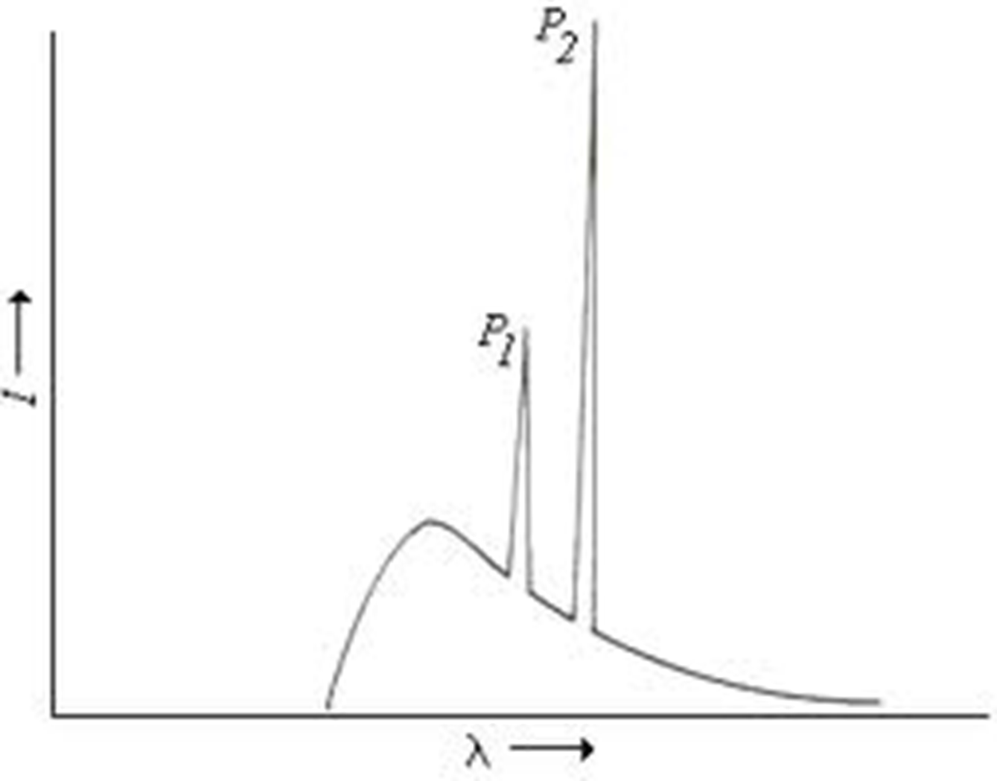
X Rays
Graph of intensity vs. wavelength
Some intensity throughout
Also some sharper peaks
Sharp peaks depend on the target material
Must have voltage past a certain value (threshold voltage) to see the lines
Continuous radiation = bremsstrahlung (braking radiation) – electrons emit radiation when they accelerate inside the target

Slide 11
Energy of electron transformed to photon

Slide 12
X Rays Continued
All radiation does not have the calculated wavelength because many electrons are not stopped in one collision

Slide 13
Bragg’s Law
Diffraction grating can be used to measure the wavelength of ANY electromagnetic wave if we can find the right line spacing

Slide 14
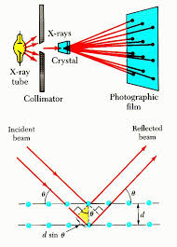
Look familiar?

Slide 15
Bragg’s Law

Slide 16
Importance of X-Ray Diffraction
Used to determine atomic arrangement of molecules like proteins
Franklin used x-ray diffraction to take a photo of DNA – clue for helical structure

Slide 17
Compton Effect

Slide 18
Compton Effect
1923
Compton directed an x-ray beam of a certain wavelength at a block of graphite
Scattered x-rays had a slightly longer wavelength than incident
Energies of scattered rays were lower
Energy reduction depended on the angle scattered

Slide 19
Compton Effect Explanation
If a photon behaves like a particle, its collision with other particles is like collisions between billiard balls
X-ray photon has energy and momentum
These quantities must be conserved
If a photon collides with an electron at rest, photon transfers some of its energy and momentum to the electron
Energy and frequency of photon are lowered
So wavelength increases

Slide 20
Compton Shift Formula

Slide 21
Compton Wavelength
Small compared to visible light
Shift in wavelength for visible light would be hard to detect

Slide 22
Duality of Light

Slide 23
Duality of Light
Light can be considered to be made of photons (particles) with energy and momentum
But light is also a wave that exhibits interference and diffraction
Light has a dual nature. It exhibits both wave and particle characteristics.

Slide 24
Duality of Light
At lower frequencies on the electromagnetic spectrum (radio waves), it may be easier to “prove” or observe light’s wave nature
At higher frequencies (x-rays), it may be easier to observe light’s particle nature
But both are true

Slide 25
Wave Properties of Particles
de Broglie – 1924
Because photons have wave and particle characteristics, perhaps all forms of matter have both properties
Electrons have dual particle-wave nature

Slide 26
Energy of a photon

Slide 27
Momentum of a Photon

Slide 28
de Broglie wavelength of a particle

Slide 29
Frequency of matter waves

Slide 30
Waves and Particles
We know that light behaves as both a wave and a particle. The rest mass of a photon is zero, and its wavelength can be found from momentum.
Wavelength of a photon:
All objects, not just EM waves, have wavelengths which can be found from their momentum
de Broglie Wavelength:

Slide 31
Finding Momentum from K.E.
In working with particles of momentum p = mv, it is often necessary to find the momentum from the given kinetic energy K. Recall the formulas:
K = ½mv² ; p = mv
Multiply first Equation by m:
mK = ½m²v² = ½p²
Momentum from K:

Slide 32
Example 5: What is the de Broglie wavelength of a 90-eV electron? (m_{e} = 9.1 x 10⁻³¹ kg.)
-
e⁻
90 eV
Next, we find momentum from the kinetic energy:
p = 5.12 x 10⁻²⁴ kg m/s
λ = 0.122 nm

Slide 33
Davisson-Germer Experiment
Measured wavelength of electrons (by accident)
Confirmation of de Broglie’s idea
Used diffraction measurements on electrons from crystals
Showed wave nature of electrons
Other experiments have showed diffraction patterns for atoms, neutrons

Slide 34
Application – Electron Microscope
Greater resolving power than optical microscope
No microscope can resolve details significantly smaller than the wavelength of the radiation used to illuminate
So electron beam lets us look at smaller objects

