Slide 1
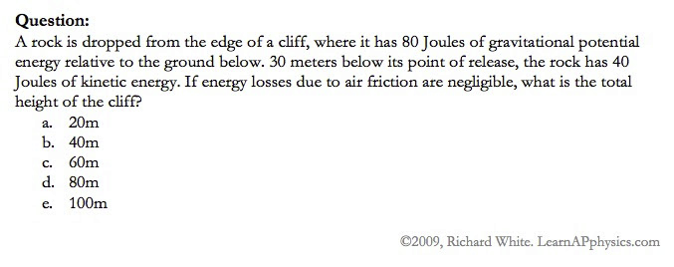

Slide 2
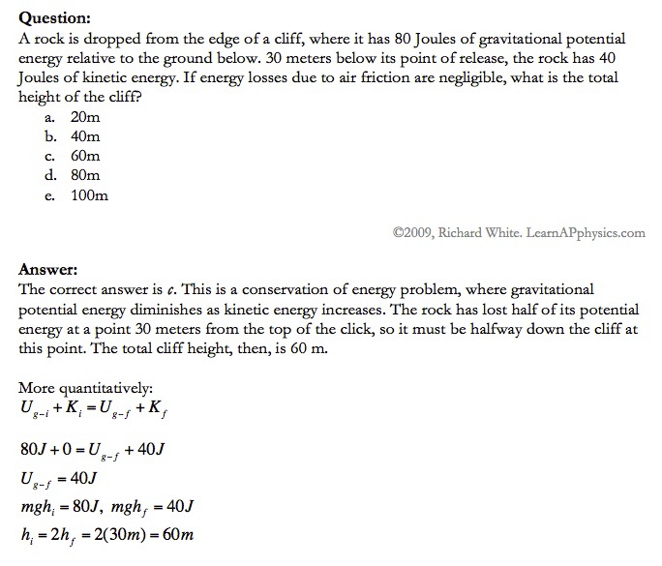

Slide 3
Plan for Today (AP Physics 2)
Ch 24, 27, and 28 Review Day
More Review Materials

Slide 4
Ch 24 Review

Slide 5
Describe and apply Young’s double slit interference
Shows light’s wave nature
A single wavelength of light goes through two slits separated by a distance d
There is an interference pattern on a screen some distance away that has bright and dark bands (equally spaced)
Bright fringes are at constructive interference, dim fringes at destructive interference

Slide 8
Young’s Double Slit Equations
Bright fringes
d * sin (O) = m * wavelength
M = 0, +/- 1, +/-2, . . .
Dark fringes
d * sin (O) = (m + ½) * wavelength
M = 0, +/- 1, +/-2, …

Slide 9
Describe and apply interference of thin films
Wavelength of light in a medium with index of refraction n is
Constructive Interference
Destructive Interference

Slide 11
Describe diffraction
Grating with multiple thin lines
Results in interference patterns
Bright central fringe, less bright fringes alternating with dark regions
Can have diffraction with x-rays at the atomic level, visible light, etc

Slide 12
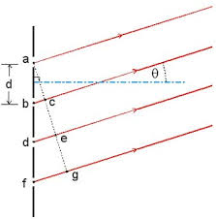
Diffraction Grating Image

Slide 13
Diffraction Grating Results

Slide 14
Diffraction Grating Equation

Slide 15
Describe and apply the single slit diffraction formula
Huygen’s principle – each portion of the slit acts as a source of waves
Destructive Interference for a single slit of width a

Slide 16
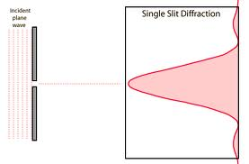
Single Slit Diagram

Slide 17
Describe polarization
N/a for this test
For electromagnetic wave, polarized light has electric field of wave all lined up/in the same direction
Electric field E vibrates in same direction AT all times in the same point
Sunglasses may do this – line up light

Slide 18
Polarization Image

Slide 20
Ch 27 Test Review

Slide 21
Describe blackbody radiation and the ultraviolet catastrophe
Blackbody Radiation
Blackbody is ideal system that absorbs ALL radiation incident on it
Radiation emitted depends on temperature of walls
Ultraviolet Catastrophe
Graph of intensity vs. frequency has extreme difference between experimental and actual at high frequencies
This would mean high frequencies of light would have huge energies (approach infinity)
Since this isn’t what happens it’s a catastrophe
Planck solved it by formulating energy is quantized

Slide 22
Blackbody Image

Slide 23
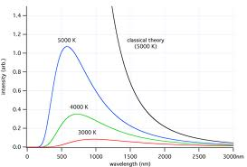
Ultraviolet Catastrophe Graph

Slide 24
Describe the photoelectric effect and the two graphs associated with it
Photoelectric effect occurs when light shines on certain metallic surfaces and electrons are emitted
Stopping potential – no electrons are emitted
Independent of intensity
No electrons emitted if light is below a cutoff frequency
Maximum KE is independent of light intensity
Max KE increases with light frequency
Electrons emitted almost instanteously

Slide 25
Photoelectric Effect Apparatus

Slide 28
Equations Associated with the Photoelectric Effect

Slide 29
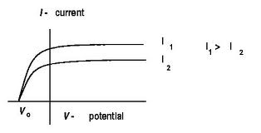
Photoelectric Effect – Current vs. Voltage Graph

Slide 30
Photoelectric Effect – Graph KE max vs. frequency

Slide 31
Find the work function, maximum kinetic energy, or energy of a photon given the other two
From a graph
From equation

Slide 32
Describe Bremsstahlung
On a graph of x-ray intensity vs wavelength, there are sharp lines, which show radiation emitted when electrons change energy levels
There is also continuous background radiation called bremsstrahlung (“braking radiation”)
Electrons emit radiation when they undergo an acceleration

Slide 34
Describe x-ray crystallography
X rays are along the scale of an atom
So we can use x rays to figure out the spacing of atoms because we can study their diffraction pattern

Slide 35
Bragg’s law

Slide 38
Describe the Compton effect
Scattered x-rays have longer wavelength than incident x-rays
Energy reduction depends on angle at which the x-rays are scattered
X-ray photons have measurable energy and momentum
When they hit electrons, they transfer some of that energy

Slide 39
Compton Effect Equation

Slide 41
Describe the duality of light
Light has properties of waves and particles
Different experiments show the different properties of light
In the visible region – able to observe both
At higher frequencies – easier to notice particle
At lower frequencies (radio waves) – easier to notice wave
Certain experiments showed one or the other
Young’s double slit = wave,
Davisson-Germer = all matter has wave nature
Compton Effect = particle
Photoelectric effect = particle

Slide 42
Describe a de Broglie wave
De Broglie postulated all forms of matter have both wave and particle characteristics
Electrons have dual particle-wave nature
So that means we can find the wavelength of any matter
Davisson-Germer showed this for electrons

Slide 43
De Broglie Wave Equation

Slide 44
Ch 28 Review

Slide 45
Use Ballmer or Lyman series to describe the energy levels of an electron
Electrons are in energy levels
They can jump to a higher energy level by ABSORBING energy (photons)
They can jump to a lower energy level by EMITTING energy (photons)
When they jump down (emit energy) they emit it in the form of photons which have wavelengths in the visible spectrum
Have mission spectrum
Way to ID the element
Higher n means shorter wavelength

Slide 47
Equation

Slide 49
Create an energy level chart including the ionization and ground state
If given an energy level chart, can you figure out how much energy is emitted (high to low) or absorbed (low to high)
Can you figure out all the possibilities (jumping straight from n = 4 to n = 1, jumping n = 4 to 2 to 1, n = 4 to 3 to 1, n = 4 to 3 to 2 to 1, etc)

Slide 50
Electron Energy Level Chart

Slide 51
Calculate the frequency of light given off when an electron drops to a specific energy level
Find the energy difference
Then we have the energy of a photon (the difference between the energy levels) is h * f. Just solve for f and you have your frequency

Slide 53
Test Format
15 AP multiple choice
2 AP Free Response

Slide 54
Big Ideas to study
Young’s Double Slit/Single Slit/Diffraction Grating (we’ve seen it in several AP free response problems)
Photoelectric effect and what the graph of it means (we’ve seen it in lab, on HW)
Wave vs. particle nature of light
Electromagnetic spectrum and high vs. low energy
Electron energy levels
De Broglie relationship between energy, momentum, and wavelength
Compton Effect

