Slide 1
Plan for Today (AP Physics I)
Turn in Pendulum Lab
Quests back
AP Problem Questions
Lecture/notes on Simple Harmonic Motion

Slide 2
Laser Disk 31-37

Slide 3
Simple Harmonic Motion
Requires – force proportional to displacement
High force, big displacement
Force opposes motion
  Restoring force points TOWARDS equilibrium

Slide 4
Block on Spring
Vibrates between –A and + A
A = amplitude

Slide 5
Mass on Pendulum

Slide 6
Notation
T = period = time for one cycle
f = frequency (Hz) – cycles per unit of time
T = 1/f
f = 1/T

Slide 7
Graphs

Slide 8
Graphs

Slide 9
Graphs

Slide 10
Graphs

Slide 11
Graphs

Slide 12
Acceleration as a function of displacement
F = ma
a = F/m
2nd law – how do we replace F with a function of x?
Some constant
F = -kx
  Negative because force opposes motion
a = -kx/m

Slide 13
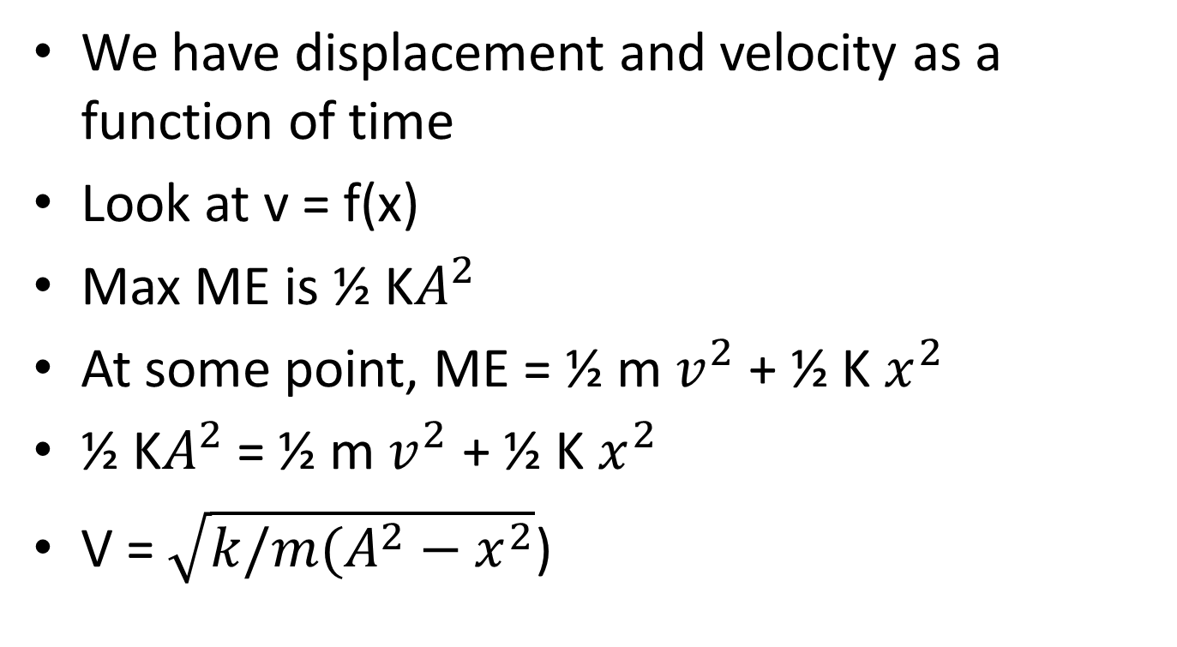
Velocity as a function of displacement
We have displacement and velocity as a function of time
Look at v = f(x)
Max ME is ½ K$A^{2}$
At some point, ME = ½ m $v^{2}$ + ½ K $x^{2}$
½ K$A^{2}$ = ½ m $v^{2}$ + ½ K $x^{2}$
V = $\sqrt{k/m(A^{2}−x^{2}}$)

Slide 14
From the videos
SHM is one dimension of circular motion

Slide 15
For students in calculus
What would v and a be?

Slide 16
For students in calculus
What would v and a be?

Slide 17
For a spring mass

Slide 18
From law of Conservation of Energy

Slide 19
For mass on a spring

Slide 20
So
What happens to T when we increase A?
  Nothing
  A is not in the equation

Slide 21
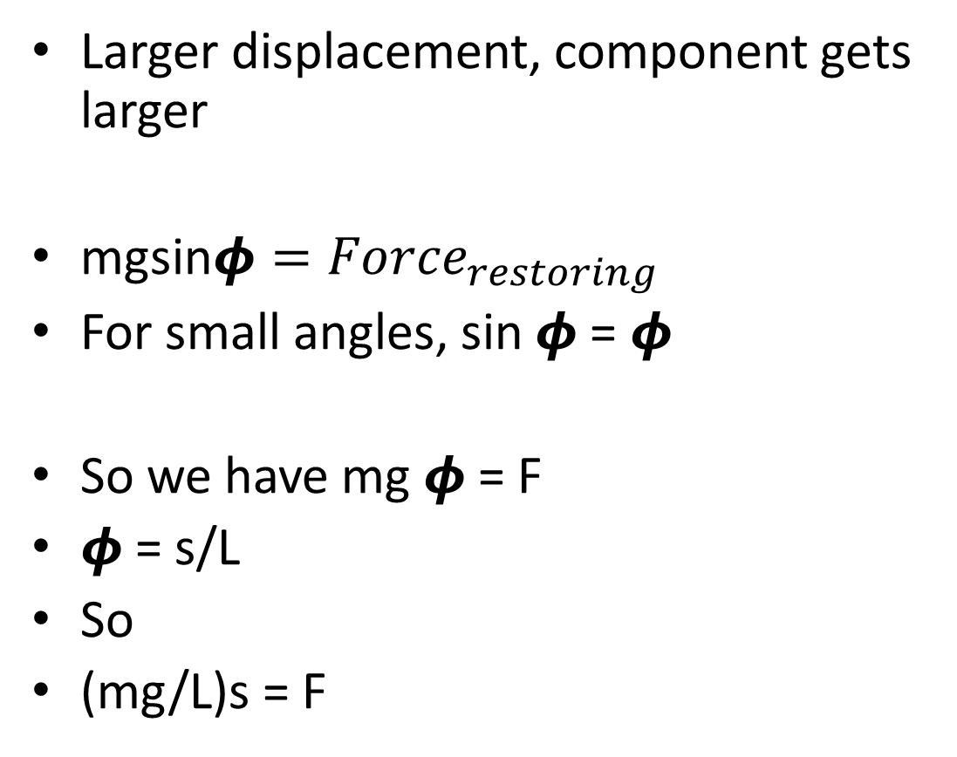
Pendulum
Larger displacement, component gets larger
mgsin$φ={Force}_{restoring}$
For small angles, sin $φ$ = $φ$
So we have mg $φ$ = F
$φ$ = s/L
So
(mg/L)s = F

Slide 22
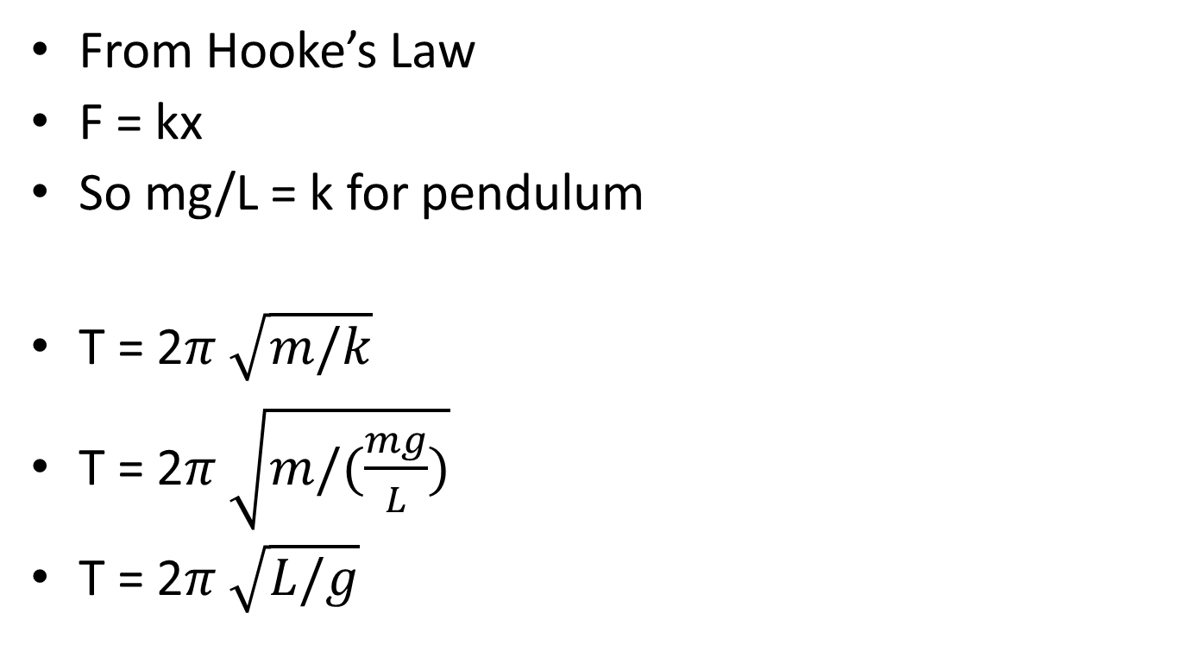
Pendulum
From Hooke’s Law
F = kx
So mg/L = k for pendulum
T = 2$π \sqrt{m/k}$
T = 2$π \sqrt{m/(\frac{mg}{L})}$
T = 2$π \sqrt{L/g}$

Slide 23
How does this equation relate to our lab?

Slide 24
Example Problems

