Slide 1
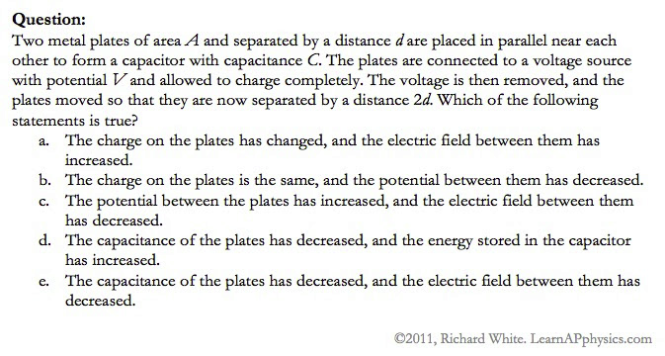

Slide 2
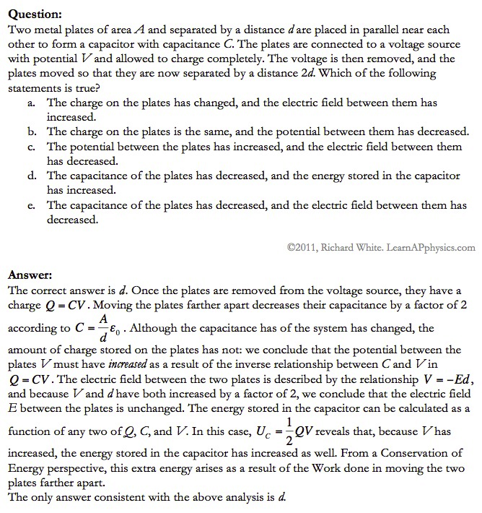

Slide 3
Plan for Today (AP Physics 1)
In class review day
Go over AP Problems
Study for Test tomorrow

Slide 4
Describe and calculate binding energy
Mass Defect = difference in masses between starting products and ending products
Binding energy is the energy released when particles are split apart OR the energy needed to break particles apart
You can find per nucleon by taking the total binding energy and dividing by the number of nucleons
Binding energy = E = mc^2 where m is the mass defect
If m is in amu, then for c^2, you can use 931.5 (then your energy is in MeV)

Slide 5
Describe half life and how to calculate the decay constant and find reactivity after some period of time
Half life is theoretical time period for one half of the radioactive substance to decay
$T_{1/2}$ = ln(2)/λ
λ is the decay constant
Reactivity = activity = R
R = change in amount/change in time
R = λ * N

Slide 6
Discuss the types of exposure you might encounter in the course of a year and what background radiation is
Background radiation – radiation we encounter in our everyday lives
Radiation coming from radioactive substances we encounter
Exposure from xrays, flight, smoke detectors, power plants, where you live, etc (see dose sheet)
Some radiation is normal and not considered harmful

Slide 7
If a nuclear spill which generated alpha particles occurred near you, describe the measures you would take. How does the answer change if it is beta or gamma?
Alpha particles are stopped by paper or just a few inches of air
So keep your distance or be covered
Beta is stopped by something like aluminum foil so keep more distance and be covered by something sturdier
Gamma radiation is the most penetrating – would want to have a lead vest or something

Slide 8
Describe radiocarbon dating
Carbon-14 is naturally occurring in all living substances and is radioactive
After a living thing dies, carbon-14 will start to decay
By looking at what percent is left, we can figure out how old the bones/sample is/are

Slide 9
Plot the decay process of uranium or find daughter elements for alpha and beta decay
Alpha decay is a helium nucleus being released
The mass number decreases by 4 and the atomic number decreases by 2
Beta minus decay is a neutron splitting into a proton and electron
The mass number stays the same and the atomic number increases by 1
Be able to keep track or follow a sequence

Slide 10
Additional Test Hints
Be able to analyze a graph showing amount of a radioactive substance over time
Know the differences between alpha, beta, and gamma and how they can be stopped
Be able to find the mass number and atomic number of an atom
Be able to calculate kinetic energy and momentum in a nuclear reaction
Be able to convert to moles
Be able to find the mass defect and binding energy
Be able to make conversions between values per reaction and values per mole, mass, etc.

