Slide 1
Plan for Today (AP Physics 1)
Notes/Lecture on Sound

Slide 2
Things to get ready
Website
Decibel reader
Laser Disk
Paper

Slide 3
Laser Disk
16, 22, 21, 26, 27, and 28

Slide 4
Sound
Is a longitudinal wave
Important to remember

Slide 5
Demos
If I talk to you with my back to you…
Can you still hear me?
Why?

Slide 6
Demo 2
If I whisper while walking away from you. . . .
Can you still hear me?
Why can’t you keep hearing me indefinitely?

Slide 7
Sound Big ideas
Sound spreads out in a sphere
As we speak, we have a set energy of our voice
That energy spreads out in a circle
It gets less intense as it moves out

Slide 8
Intensity
What is intensity?
I
I = Power/Area
What are the units?
W/$m^{2}$

Slide 9
Intensity
What would the area be?
Sound spreads out in a sphere
So the surface area of a sphere is. . .
SA = 4$πr^{2}$
I = $\frac{P}{\text{4}πr^{2}}$

Slide 10
Example Problem
A speaker gives off .5 W of power. Find the intensity of it at 1 and 5 m.

Slide 11
Example Problem
A speaker gives off .5 W of power. Find the intensity of it at 1 and 5 m.
A: 0.040 W/m^2
A: .0016 W/m^2

Slide 12
Observations about answers
Numbers are very small

Slide 13
Efficiency of a Speaker
Normally we buy a speaker by power
These values are 20 to 50 W
So why did we only use .5 W in the example?
50 W is the power consumed by the speaker
0.5 W is the power output
Speakers are VERY inefficient

Slide 14
Speakers Continued
Speakers are pushing air
Demo
If I take a piece of paper and fan someone by pushing the paper towards him/her
Very little air gets to you, but I am working hard

Slide 15
Sound Intensity
We define sound intensity by human experience
Same as we do with frequency (focusing on what frequencies we can hear)

Slide 16

Sound Intensity Range
For Humans
Threshold of hearing $I_{0}$
.000000000001 W/$m^{2}$
Top end $I_{P}$
1 W/$m^{2}$
What does the p stand for?
Pain
Threshold of pain

Slide 17
Can we hear above the threshold of pain?
Yes
But the fact that there is pain means damage is being done

Slide 18
Human Range
It’s amazing all the sound intensity levels we can hear
From 1 W/$m^{2}$ all the way to ${10}^{−12}$ W/$m^{2}$
But these values are harder to understand
So we can to transform to more usable numbers
What units do we use?

Slide 19
Decibels
dB
What is it named for?
Deci = 10
Bell = Alexander G Bell

Slide 20
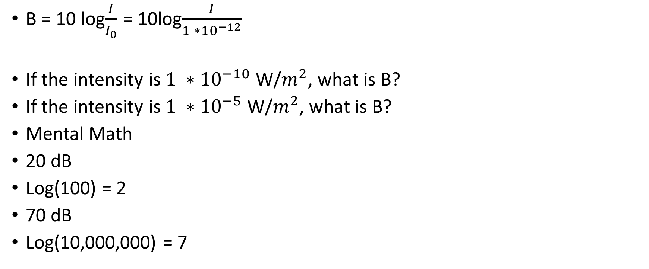
Equation for Bell
B = 10 log$\frac{I}{I_{0}}$ = 10log$\frac{I}{1 ∗{10}^{−12}}$
If the intensity is $1 ∗{10}^{−10}$ W/$m^{2}$, what is B?
If the intensity is $1 ∗{10}^{−5}$ W/$m^{2}$, what is B?
Mental Math
20 dB
Log(100) = 2
70 dB
Log(10,000,000) = 7

Slide 21
Example
If the intensity is 0.0035 W/$m^{2}$, what is B?
B = 10 log $\frac{0.0035}{1 ∗{10}^{−12} }$
= 95 dB

Slide 22
Decibel Demo
Using the decibel meter, measure the level when you (as a class)
Whisper
Talk
Yell
How can we increase the readings?
If we get closer
Let’s try again

Slide 23
Decibel Website
Relationship between intensity and human experience for the volume increase
http://www.phy.davidson.edu/fachome/dmb/DecibelSize/Decibelsize.html

Slide 24
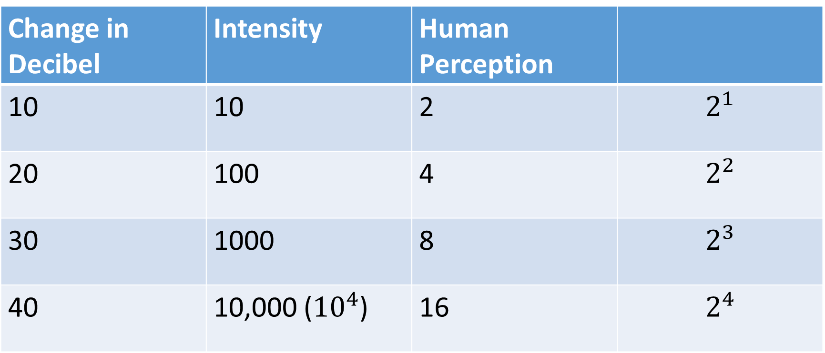
Decibels and Human Perception
Change in Decibel | Intensity | Human Perception
10 | 10 | 2 | $$2^{1}$$
20 | 100 | 4 | $$2^{2}$$
30 | 1000 | 8 | $$2^{3}$$
40 | 10,000 (${10}^{4}$) | 16 | $$2^{4}$$

