Slide 1
Plan for Today (AP Physics I)
Lecture/Notes on Doppler Effect
Finish Sound Station Lab

Slide 2
Demonstration
Listen to the speaker
Now if I swing it around my head
What is happening?
Pitch is high as it’s coming toward you and low as it moves away

Slide 3
Demonstration

Slide 4
Demo Discussion
What is this called?
Doppler effect
We have a change in frequency because of relative velocity of sound
2 cases – we can have an actual change in the velocity of sound and an apparent change

Slide 5
Laser Disks
26 – speed of sound and light – 5 sec rule
27 – examples of Doppler
28 – wave tank – how waves build up in front – wavelength decreases so frequency increases
In back wavelength increases so frequency decreases

Slide 6
Going very fast
When you go faster than the speed of sound what is this?
Sonic Boom
Or faster than waves – jumping wake when water skiing

Slide 7
Sonic Booms
The government banned super sonic travel above cities
So we don’t hear it much
It could rattle dishes
Around air forces, they can still hear

Slide 8
Laser Disk
29 – actual frequency change
Waves bunch up

Slide 9
Equation Information
$V_{s}$ = Velocity of source
Actual frequency change
Waves bunch up
$V_{o}$= Velocity of observer
Apparent change – catching up with the wave

Slide 10
More Equation Information
We have to take into account both the velocity of the source and the observer

Slide 11
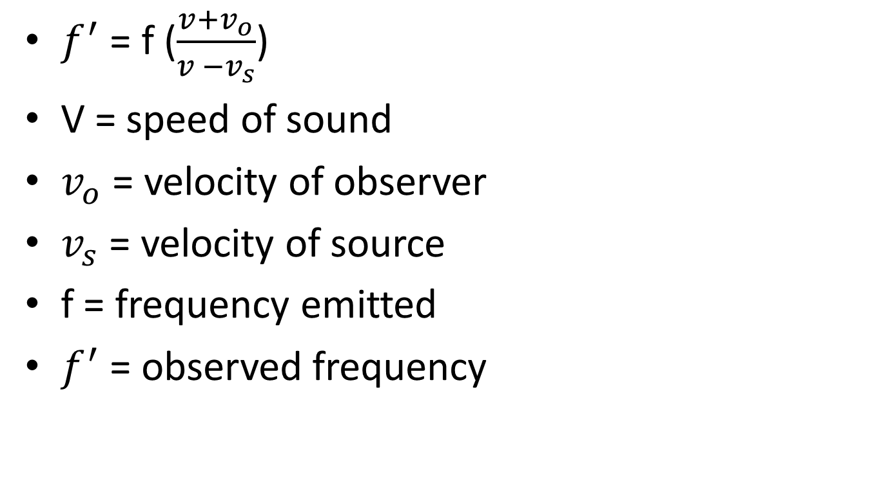
Equation
$f^{′}$ = f ($\frac{v+v_{o}}{v −v_{s}}$)
V = speed of sound
$v_{o}$ = velocity of observer
$v_{s}$ = velocity of source
f = frequency emitted
$f^{′}$ = observed frequency

Slide 12
Sign Conventions for Equation
If either observer or source is going towards the other, it’s positive
If either observer or source is going away it’s negative

Slide 13
Example

Slide 16
Doppler Effect Example
An observer is moving towards an emitted sound at 15 m/s while the sound is moving away at a speed of 20 m/s. Assume the speed of sound in air is 340 m/s. If the observer hears a frequency of 440 Hz, what is the actual frequency of the emitted sound?

Slide 17
Lab Groups – 4th Hour

Slide 18
Lab Groups – 7th Hour

