Slide 1
Plan for Today (AP Physics)
Lecture on Resonance – Waves in Pipes, Beats
Finish Speed of Sound Lab (Thursday)
Practice Worksheet

Slide 2
Resonance

Slide 3
Things to Consider
Spring mass demo
4 pendulums from lab
2 boxes with tuning fork
Opera singer breaking glass
Sub wolfers rattling windows

Slide 4
What happens?
Objects are being excited by a force that matches the natural frequency

Slide 5
Natural frequency
Frequency that an object wants to vibrate at
Ex – with 2 m stick
If I hold it at the end and shake
Vs if I hold from the middle
Yes different frequencies depending on where held, but always the same for a specific configuration

Slide 6
Example of Natural Frequency
Brain-Bowels – 7 Hz
Army tried to make a non-lethal method of crowd control
  Would send out a soundwave to get the stomach and bowels to resonate (brown note)
  But they couldn’t get enough response
Shaken baby syndrome – example of this

Slide 7
Tachoma Narrows bridge Video
Would not have happened if wind speeds had been much different (above or below 42 mph) (+/- 5 mph)

Slide 8
Response Spectra
Graph
Near natural frequency we see a large amplitude of motion

Slide 9
Earthquake design

Slide 10
How Engineers Model Buildings

Slide 11
Key is that force matches the natural frequency
Tube with bunsen burner is an example of this
  All other frequencies die out
  Natural frequency gets large amplitude response

Slide 12
Sound in pipes
End conditions rule
Open end
  Creates an antinode
  Area of maximum motion
Closed end
  Creates a node
  Area of no motion
  Imagine a particle next to the wall – can’t move

Slide 13

Pattern
Fundamental – Open pipe
L = ½ λ
λ = 2L
$f_{n}$ = $\frac{v}{\text{λ} }$ = $\frac{v}{2L}$

Slide 14

Second Harmonic
L = λ
$f_{n}$ = $\frac{v}{\text{λ} }$ = $\frac{v}{L}$

Slide 15

Third Harmonic
L = 3/2 λ
2/3 L = λ
$f_{n}$ = $\frac{v}{\text{λ} }$ = $\frac{3v}{2L}$

Slide 16
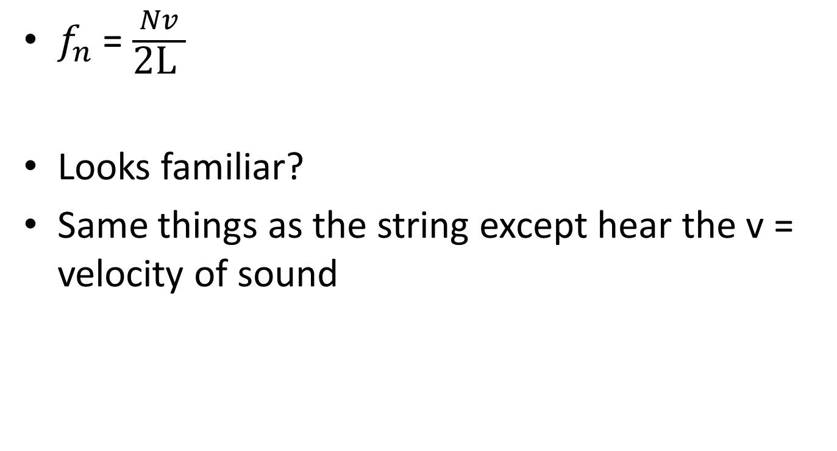
Formula for Pipes with Two Open Ends
$f_{n}$ = $\frac{Nv}{\text{2}\text{L} }$
Looks familiar?
Same things as the string except hear the v = velocity of sound

Slide 17

Closed End
1st harmonic
L = ¼ λ
4L = λ
$f_{n}$ = $\frac{v}{4L}$

Slide 18

Next
L = ¾ λ
4/3 L = λ
$f_{n}$ = $\frac{3v}{4L}$

Slide 19

Next
L = 5/4 λ
4/5 L = λ
$f_{n}$ = $\frac{5v}{4L}$

Slide 20

Equation for Pipe with one closed end
$f_{n}$ = $\frac{Nv}{4L}$
But N = 1, 3, 5, 7 . . ..
Odd harmonics only, not even

Slide 21
Worksheet to practice

