Slide 1
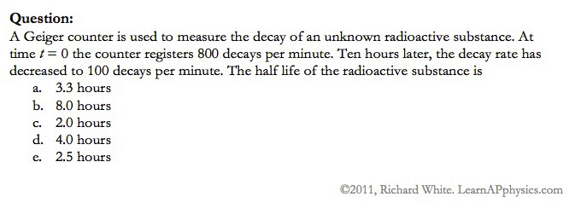

Slide 2
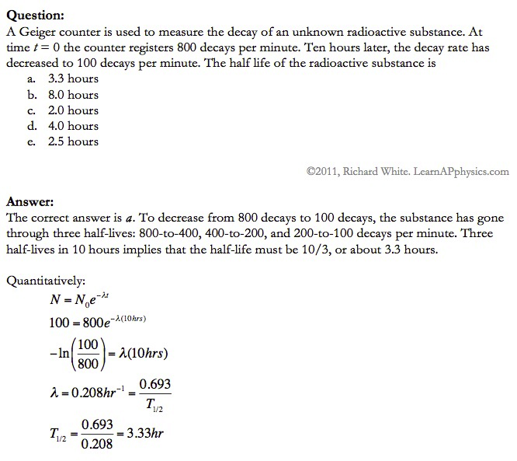

Slide 3
Plan for Today (AP Physics 2)
B testers
Go over AP Problems
Thermo Review
C Testers
Go over yesterday’s problems
Parallel Axis Theorem

Slide 4
Go over yesterday’s worksheets

Slide 5
Parallel Axis Theorem
Our previous equations for moment of inertia involved rotating symmetrical objects about an axis that passes through their center of mass
What happens when we don’t
This is the parallel axis theorem

Slide 6
Parallel Axis Theorem
If we have an object rotating about an axis that passes through the body’s center of mass
We get a moment of inertia with respect to that axis

Slide 7
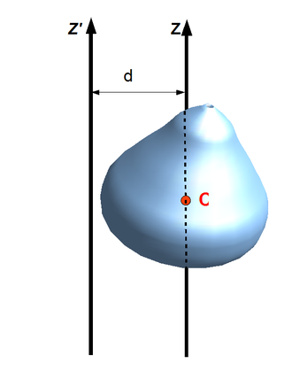
Parallel Axis Theorem
If we then make the object rotate about a new axis (parallel to the first, but moved over)
Then our new moment of inertia is
I = I_{cm}+ mR²

Slide 8
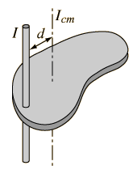
Parallel Axis Theorem Restated
The moment of inertia of any object about an axis through its center of mass is the minimum moment of inertia for an axis parallel to it
The general moment of Inertia would be
I_{parallel} = I_{cm} + mR²

Slide 10
Example Problem
Three identical thin rods, each of length L and mass m, are welded perpendicular to one another. The assembly is rotated about an axis that passes through the end of one of the rods and is parallel to another. Determine the moment of inertia of this structure about this axis.

Slide 11
Solution to example problem
Assume the rods are thin – radius much smaller than their length
Center of mass would be in the center of the structure
The axis of rotation is parallel to the y axis, so we can calculate the moment of inertia about the y axis and then use the parallel axis theorem for our axis of rotation
The moment of inertia of the rod on the y axis about the y axis is zero – axis through center, rod is thin
The other two rods are rotated through the center so we have I = 1/12 m L^2

Slide 12
Solution Continued
I_{cm}= I_{on x-axis}+ I_{on y-axis}+ I_{on z-axis} =
1/12mL² + 0 + 1/12mL²
= 1/6mL²
Now apply parallel axis theorem
I = I_{cm}+ 3m(L/2)²
I = 1/6mL²+ 3/4mL² =
I = 11/12mL²

Slide 13
Additional Example Problem
Many machines have cams, such as opening and closing values. In the diagram, the cam is a circular disk of radius R with a hole of diameter R cut through it. As shown in the figure, the hole does not pass through the center of the disk. The cam with the hole cut out has mass M. The cam is mounted on a uniform solid, cylindrical shaft of diameter R and also of mass M. What is the moment of inertia of the cam-shaft combination when it is rotating about the shaft’s axis?

Slide 14
Solution
The cam is a solid disk – radius R – that has a small disk of radius R/2 cut out
Use the parallel axis theorem to find the moment of inertia of the solid disk about an axis at R/2 from center of mass, then subtract off the moment of inertia of the inertia of the small disk of radius R/2 from the center
Moment of Inertia of solid disk about axis R/2 from center of mass
I_{disk} = I_{cm} + M_{disk}(R/2)²
= ½ M_{disk}R² + 1/4M_{disk}R²
= ¾ M_{disk}R²

Slide 15
Solution Continued
With half the radius, the small disk cut away has ¼ the area so ¼ the volume and ¼ the mass of the original disk
The moment of inertia of the small disk of radius R/2 about an axis through it’s CM is
I_{small disk} = ½ M_{small disk} (R/2)²
= ½(1/4 M_{disk})(R²/4)
= 1/32 M_{disk}R²
Then we subtract the moment of the small disk from the solid disk
I_{cam} = I_{disk} – I_{small disk}
= ¾ M_{disk}R²-1/32M_{disk}R²
⁼ 23/32M_{disk}R²

Slide 16
Solution Continued Continued
The mass of the cam is M = M_{disk} – M_{small} _{disk} = M_{disk} – ¼ M_{disk} = ¾ M_{disk}
I_{cam} = 23/32M_{disk}R²(M/[3/4 M_{disk}])
= MR²(23/32)(3/4)
= 23/24 MR²
Moment of Inertia of the Cam-shaft sum of moments of cam and shaft
I_{cam-shaft} = I_{cam} + I_{shaft} = 23/24 MR² + ½ M(R/2)²
= 13/12 MR²

Slide 17
Additional Worksheet

