Slide 1
Plan for Today (AP Physics I)
Lecture/Notes on Coulomb’s Law
Worksheet

Slide 2
Who is gone on Friday?
(Special Olympics, sports events, etc)

Slide 3
Homework Due Date

Slide 4
Coulomb’s Law
There is an attractive force proportional to the two charges and inversely proportional to the distance squared
What is the formula?

Slide 5
Equation
$F_{E}$ = $\frac{kq_{1}q_{2}}{r^{2}}$
Does this look familiar?
Looks like gravity – can think of like that equation
$F_{G}$= $\frac{Gm_{1}m}{r^{2}}$

Slide 6
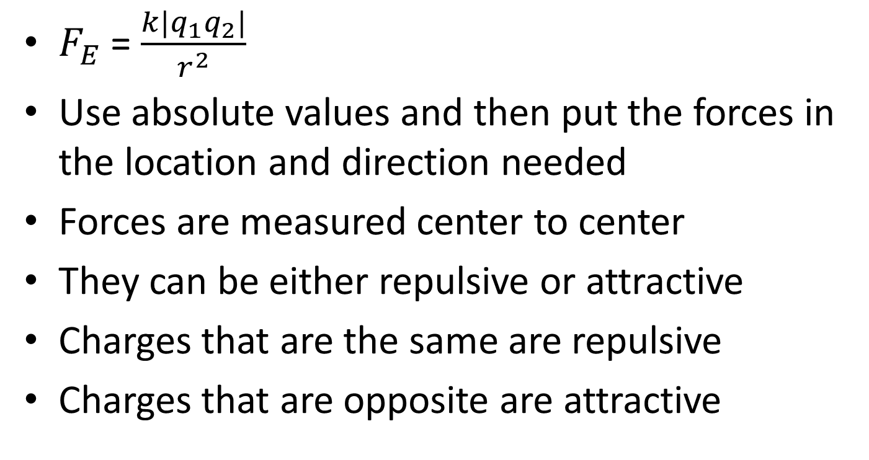
Coulomb’s Law Continued
$F_{E}$ = $\frac{k{|q}_{1}q_{2}|}{r^{2}}$
Use absolute values and then put the forces in the location and direction needed
Forces are measured center to center
They can be either repulsive or attractive
Charges that are the same are repulsive
Charges that are opposite are attractive

Slide 7
That constant
k = 8.99 * ${10}^{9}$
What are the units?
Find them!
$\frac{Nm^{2}}{C^{2}}$ or N$m^{2}C^{−2}$

Slide 8
Example Problems

