Slide 1
Plan for Today (AP Physics I)
Lecture/Notes on Electric Fields

Slide 2
Remember
Relationship between FE and FG

Slide 3
We have g, which is an acceleration of a mass in a gravitational field
If we put a mass in the “field”, what happens?
It falls/goes towards Earth
Equation F = mg

Slide 4
We need a similar concept in electrostatics
We have charged objects, which cause electric fields around them
If you held the Vandergraph generator, you could feel the field

Slide 5
Example/Demo
If I put a charge on a balloon on a string,
Then put it near the Vandergraph
Watch the balloon react when it gets near
We can see how the space around the Vandergraph is effected

Slide 6
Something like “g”
We have
Something similar
What is E?
E = electric field strength

Slide 7
What this means
If E = 200 N/C, this means if I put a 1 C charge in this field, it will experience a 200 N force

Slide 8
Tie in to Newton’s 2nd Law

Slide 9
Direction is a problem
With g, the direction was always the same (down)
Earth only “sucks”
With E, it can repel or attract

Slide 10
Direction Definition
The electric field points in the direction a positive test charge would flow
Example
Put a positive charge in the field

Slide 11
Example
How does the electric field look?

Slide 12
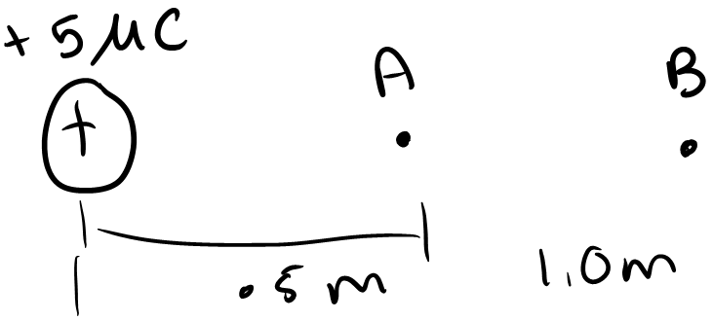

Slide 13
If we put a 2 test charge at A and then at B, can we find the force acting on it.
We don’t have to use F = kq1q2/r^2 because of Newton’s 2nd law
F = ma or F = qE

Slide 14
Ea = 180000 N/C
Fa = .36 N
Eb = 45000 N/C
Fb = .0899 N

Slide 15
Example
Find the electric field at point C from the two charges

Slide 16
Now what is the force on a charge of +2 put here?

Slide 17
Assignment
Work on the Coulomb’s worksheet
Find the electric field at the points assigned and the force on a test charge there

