Slide 1
Plan for Today (AP Physics 2)
C Testers
Physical Pendulum Notes and Example Problem
B Testers
Light and Optics Review

Slide 2
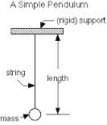
Pendulums
In the past, pendulums have been a string with a small mass attached to the end
We used the equation T = 2π $\sqrt{\frac{L}{g}}$
L was the length of the pendulum
T = period of the pendulum
g = gravity

Slide 3
What if we have a different kind of pendulum
We can have a hanging object oscillate back and forth like a pendulum
Instead of a mass, what if we have a rod or some other shape that is swinging back and forth
This is called a physical pendulum

Slide 4
Physical Pendulum Equation
$τ=I ɑ$
$τ$ = FR = -mgL_{cm} sin ϴ
Moment of inertia is about the point of suspension
Solving for angular acceleration
$ɑ$ = - $\frac{mgL_{cm}}{I_{support}}$ϴ
Subbing in sinϴ for ϴ because angle is small
$ɑ$ = d²ϴ/dt²

Slide 5
Physical Pendulum Continued
But for periodic motion, d²x/dt² = -$\frac{k}{m}$x
w² = k/m
w = $\sqrt{\frac{I_{support}}{mgL_{cm}}}$
Plugging in to Period of the Pendulum Equation
T = 2π / w
T = 2π $\sqrt{\frac{I_{support}}{mgL_{cm}}}$

Slide 6
Physical Pendulum Equation

Slide 8
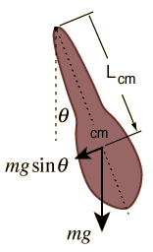
Physical Pendulum

Slide 9
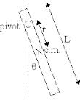
Rod Physical Pendulum

Slide 10
Physical Pendulum Rod - Example

Slide 11
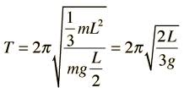
For a rod connected at one end

