Slide 1
Plan for Today (AP Physics 2)
C Testers
SHM Review and Problems
B Testers
Finish light review and go over AP Problems

Slide 2
Simple Harmonic Motion
Like a mass on a spring
Motion is like a sin wave in time

Slide 3
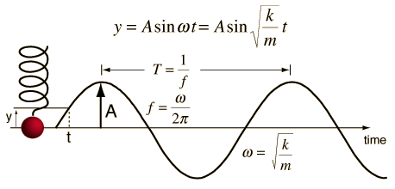
Simple Harmonic Motion

Slide 4
Simple Harmonic Motion Equations
y = A sin (wt)
x = A cos (wt)
What would the velocity equation be?
v = w A cos(wt)
What would the acceleration equation be?
a = -w²Asin(wt)

Slide 5
Simple Harmonic Motion

Slide 6
How these look on the equation sheet

Slide 7
AP Problems

