Slide 1
Get out your HW but do not turn it in
Agenda
AQOD
Go over reading guide
Notes: water, solutes, solvents
HW: 8.2 Worksheet
Why is water called the universal solvent?

Slide 2
How Substances Dissolve

Slide 3
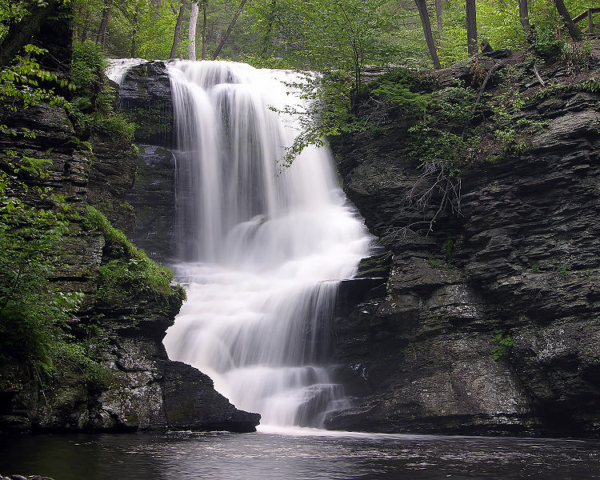
What is the universal solvent?

Slide 4
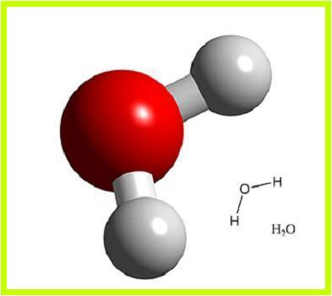
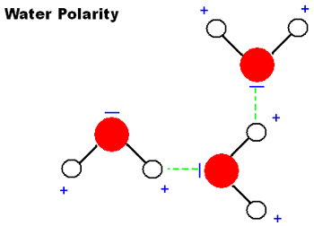
Properties of water?
Water is polar
Lets Draw water together

Slide 5
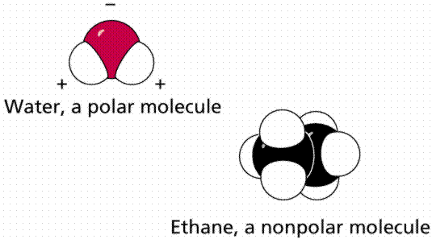
Polar vs. Nonpolar
Polar – a molecule that has a positive and a negative side
Non polar – a molecule that does not have a positive or negative side

Slide 6
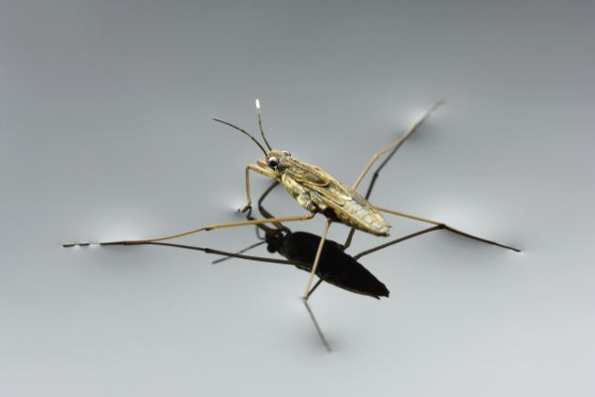
Some cool things as a result
http://www.youtube.com/watch?v=ntQ7qGilqZE
Surface tension: What happens if I put a paper clip in a glass of water?

Slide 7
Why does salt seem to disappear?
Discuss salt dissolving
Acting out the process of dissolving
Video of the process
Draw and describe the process
https://www.youtube.com/watch?v=EBfGcTAJF4o

Slide 8
Picture of Salt Dissolving

Slide 9
How does it work? Salt and H2O
1. Dissolving of a solid occurs at the surface.
2. Water is always moving
3. - oxygen is attracted to the + sodium and the + hydrogen is attracted to the - Chlorine
4. Water molecules pull Sodium and Chlorine ions apart and surround them
5. Molecules spread out

Slide 10
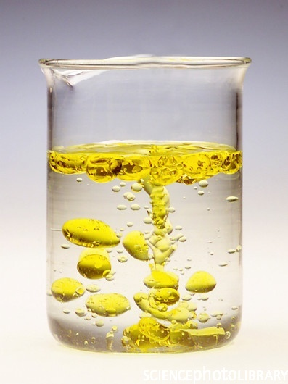
Does water dissolve everything?
No
Like dissolves like
Polar dissolves polar
Nonpolar dissolves
nonpolar

Slide 11
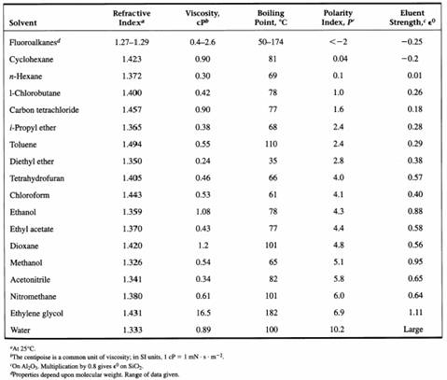

Slide 12
How would you dissolve permanent marker?
Permanent marker – polarity is 3.2
Water – polarity is 10.2
Isopropyl alcohol – polarity is 3.9
Which solvent will dissolve the permanent maker?

Slide 13
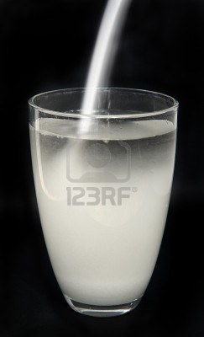
Solute vs. Solvent
Solvent – What does the dissolving
Solute – what is being dissolved
The sugar is dissolved in the water
The _______is dissolved in the ________
What are some more solutes and solvents?

Slide 14
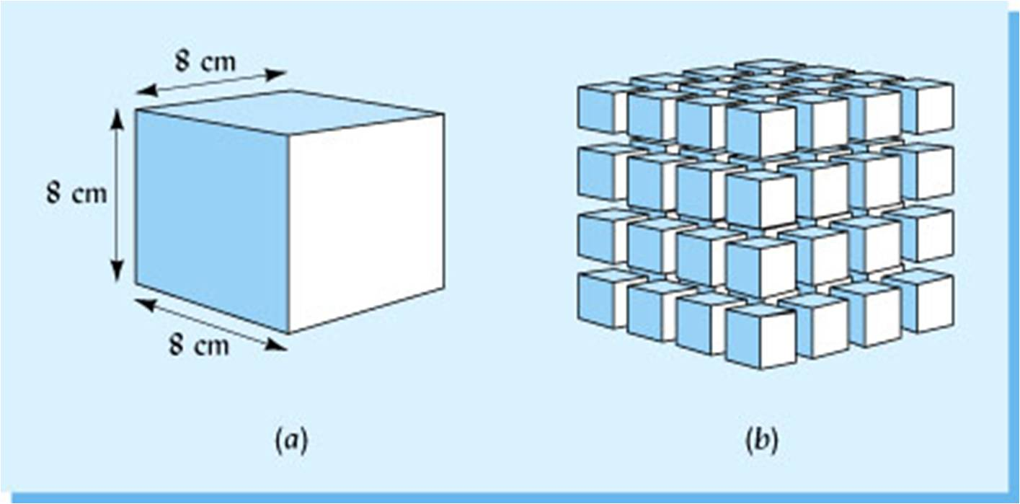
The dissolving process
The Solvent molecules has to collide with the solute molecules.
Would a solute with a large surface area dissolve faster that a solute with a small surface area?

Slide 15
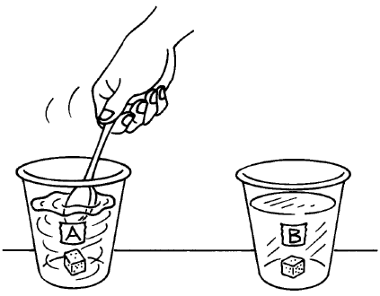
Effects of stirring
Which sugar cube will dissolve faster?
Stirring increases the sugar molecules contact with the water molecules
Stirring increases the ______contact with the _______

Slide 16
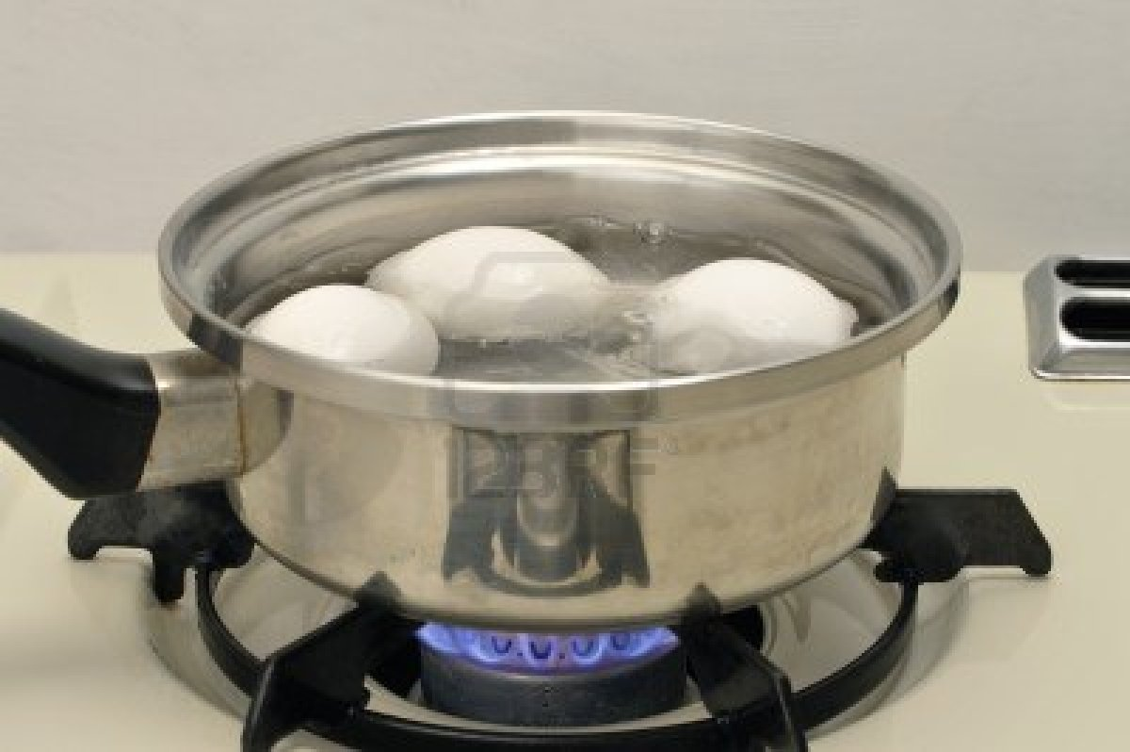
Effects of Heat
When substances are heated the molecules move faster.
If molecules move faster then the solute and solvent will collide more often

