Slide 1
Plan for Today (AP Physics 2)
C Testers
  Gravity Review
B Testers
  Finish going over MC

Slide 2
Gravity Review
F_{g} = Gm₁m₂/r²
G = 6.67 * 10⁻¹¹ Nm²/kg²
F₁₂ = - (Gm₁m₂/r²)r₁₂

Slide 4
Things to note
Gravitational force is a field force that always exists between two particles, regardless of what separates them
The force decreases rapidly with increasing separation

Slide 5
For objects on Earth
F_{g} = GM_{E}m/R_{E}²

Slide 6
Free Fall Acceleration and Gravitational Force
F_{g} = F_{g}
mg = GM_{E}m/R_{E}²
g = GM_{E}/R_{E}²
For farther away,
g = GM_{E}/r²
⁼ GM_{E}/(R_{E} + h)²

Slide 7
Kepler’s Laws
All planets move in elliptical orbits with the sun at one focus
The radius vector drawn from the sun to a planet sweeps out equal areas in equal time intervals
The square of the orbital period of any planet is proportional to the cube of the semimajor axis of the elliptical orbit

Slide 8
Kepler’s Third Law Equation

Slide 9
Kepler’s Third Law Equation

Slide 10
Gravitational Field
g = F_{g}/m

Slide 11
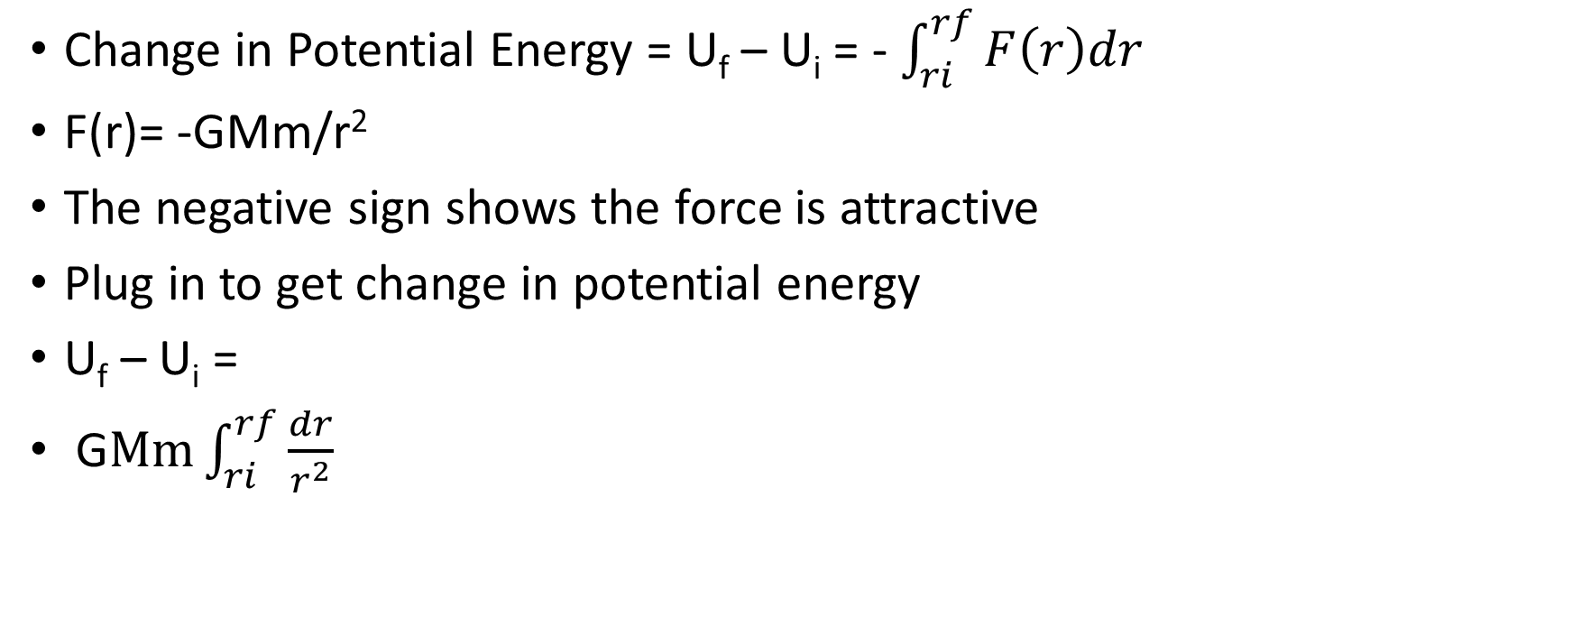
Gravitational Potential Energy
Change in Potential Energy = U_{f} – U_{i} = - $\int_{ri}^{rf}{F\left(r\right)dr}$
F(r)= -GMm/r²
The negative sign shows the force is attractive
Plug in to get change in potential energy
U_{f} – U_{i} =
G$Mm\int_{ri}^{rf}{\frac{dr}{r^{2}}}$

Slide 12
Gravitational potential energy

Slide 13
Total Energy for Circular motion

Slide 14
Escape Velocity

