Slide 1
Get out your RG but do not turn it in
Agenda
AQOD
Go over reading guide
8.3 Notes on Solubility and Concentrations
HW: Solubility curve worksheet
What is a saturated solution?

Slide 2
Solubility and Concentration

Slide 3
Salt vs. Sugar
Can you dissolve more sugar or salt in 100ml of water?

Slide 4
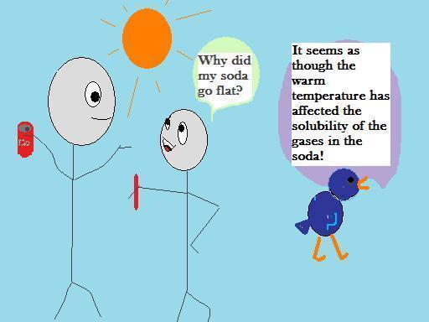
Solubility
Solubility of a substance is the ability of one substance to dissolve in another at a given temperature and pressure

Slide 5
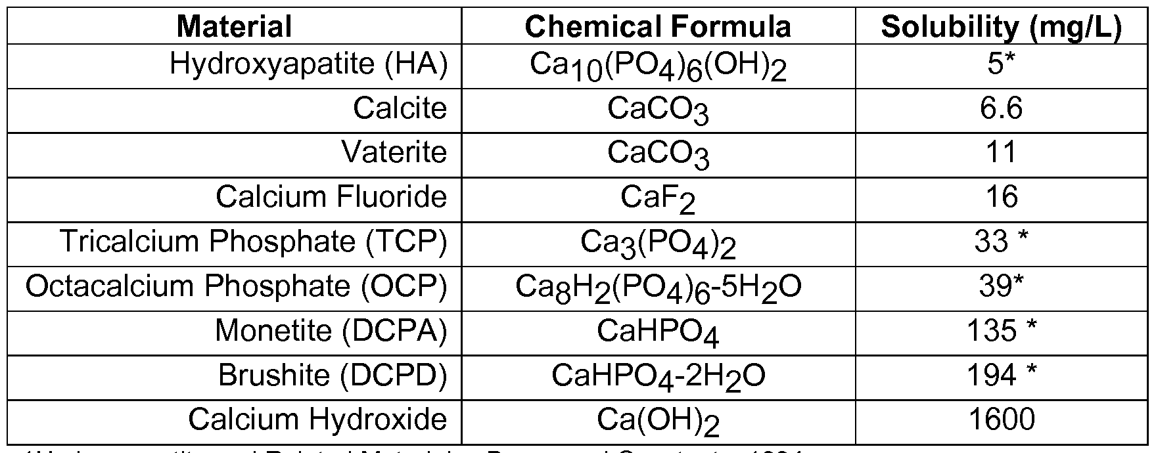
Different substances have different solubilities
Depends on the strength of the forces acting between the solute particles and the strength of the force between the water molecules and the solute.

Slide 6
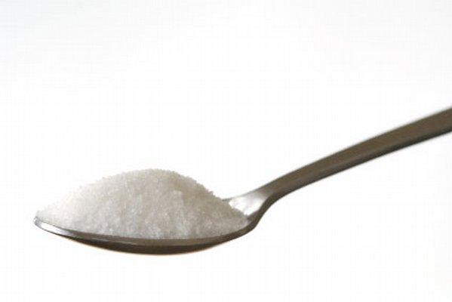
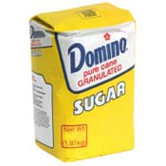
Concentration
The amount of a substance that is dissolved in another substance. High concentration vs. low concentration.

Slide 7
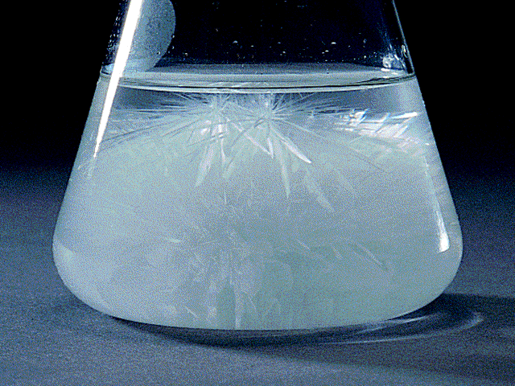
Saturated solutions
The maximum amount of solute that will dissolve at a certain temperature.
If a solution is saturated and you add more solute what will happen?

Slide 8
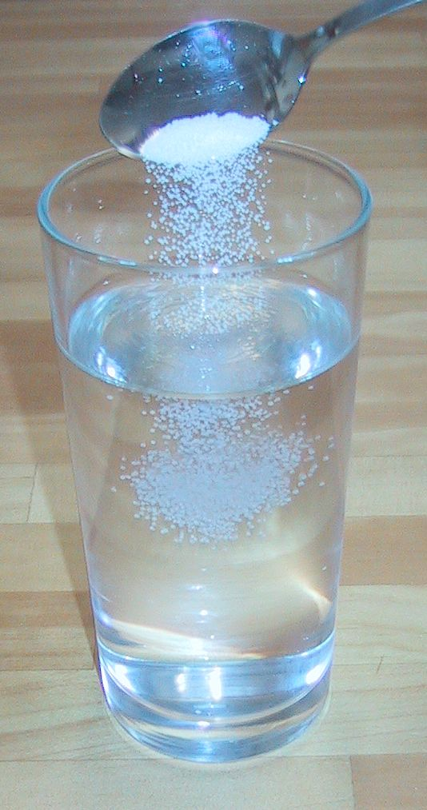
Unsaturated solution
A solution that contains less than the maximum amount of solute that can be dissolved. (I can still dissolve more solute)

Slide 9
Supersaturated solution
A solution that holds more solute than it normally would at a cooler temperature.
https://www.youtube.com/watch?v=0wifFbGDv4I

Slide 10
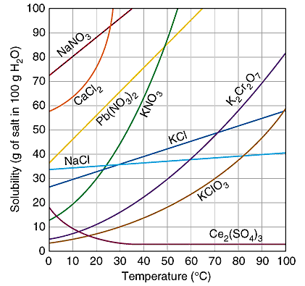
Solubility of solutes at given temperatures

