Slide 1
Plan for Today (AP Physics I)
Lecture/Notes on Ch 17, Current and Resistance

Slide 2
Test Results
Average – 85.5
Median – 89.5

Slide 3
Demonstration
Connect pickle to wall socket as shown?
What happens?

Slide 4
What happens?
The current starts to flow after the pickle heats up
  So we see a change in properties of the pickle

Slide 5
Current
Flow of charge per unit of time

Slide 6
Equation
So what is the equation of current
Use “I” to express
I = q/t
= charge/time
Units: coulombs/second = Amps (A)

Slide 7
Be careful
Symbol for current = I
Units: Amps or A

Slide 8
Example
4 amps of current flow for 3 minutes. How much charge? How many electrons?

Slide 9
Example
4 amps of current flow for 3 minutes. How much charge? How many electrons?
I = 4 A
t = 3 min = 180 s (REMEMBER TO CONVERT)
I = q/t
q = I * t = 4 * 180
= 720 C
720 C * 1 e/(1.6 * 10^-19C) = 4.5 * 10^21 electrons

Slide 10
By definition, current flows in the path a positive particle goes
Diagram
Electrons would flow counterclockwise
Current by definition flows out of positive to negative
Negative charges flowing counterclockwise is mathematically the same as positive flowing clockwise

Slide 11
Diagram of the Path Electrons Take

Slide 12
Speed of Electrons
Depends on size, shape of wire and materials
Is about 3 * 10^-4 m/s or about 1 m/hr
This is very slow
If this is true, and the speed is so slow, how does a light turn on?

Slide 13
Answer
It is “electric field” energy that travels near the speed of light that allows the light to turn on

Slide 14
What is happening when the electron bumps into atoms along the way?
Inelastic collisions
What happens in inelastic collisions?
KE converts to something
What?
Heat
Wire starts to heat up
Some of the energy (eV) is getting transferred to the wire

Slide 15
What do we need for a circuit?
A complete circular path to allow flow of electrons

Slide 16
Example
Here is a complete path with lots of electrons
But why doesn’t this motor run?
Needs a source of energy (battery)

Slide 17
Complete circuit

Slide 18
Resistors
Something that uses energy
Could be a hunk of ceramic, an oven, computer, coffee pot, any device, etc.

Slide 19
Circuit Example

Slide 20
Our assumption is that the wires don’t use up much of the battery’s energy so we ignore them
Note: battery voltage is all used up every time by the circuit – no exceptions!!

Slide 21
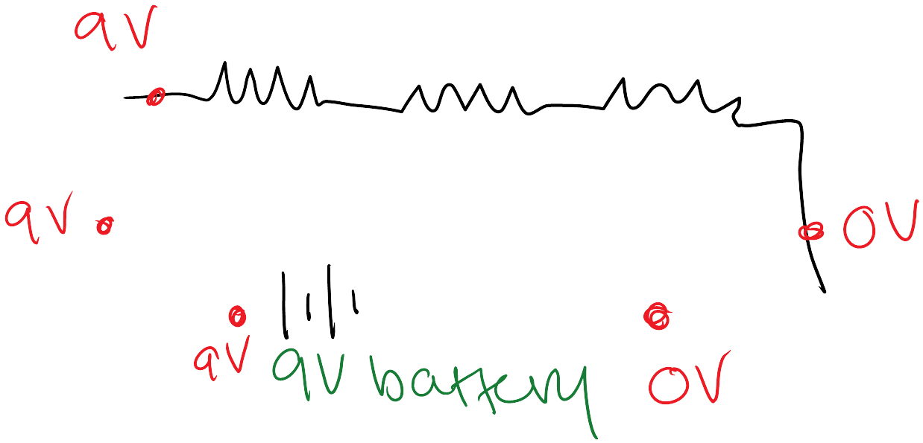

Slide 22
How to measure voltage and current
Voltage – use voltmeter
Current – use ammeter

Slide 23
Set up measuring voltage and current
Diagram
Explanation
Voltmeter measures voltage drop across a device
  So it is in parallel
To measure current, we must have current run through the device
  so it is in series

