Slide 1
Hold on to lab
Agenda
Notes over States of Matter
Heating Curve Article and Questions
HW: Work on review
AQOD
When water is boiling, what is true about the temperature?

Slide 2
States of Matter

Slide 3
4 states of matter
Solid
Liquid
Gas
Plasma

Slide 4
Particles in an object
Always in motion so they have KE always
Absolute Zero to the speed of light

Slide 5
SOLID
Particles (molecules) close together and vibrating

Slide 6
LIQUID
KE is higher
Attractive forces of particles are weaker

Slide 7
GAS
Attractive force is less so particles are even farther apart. High energy
Has no definite shape or volume

Slide 8
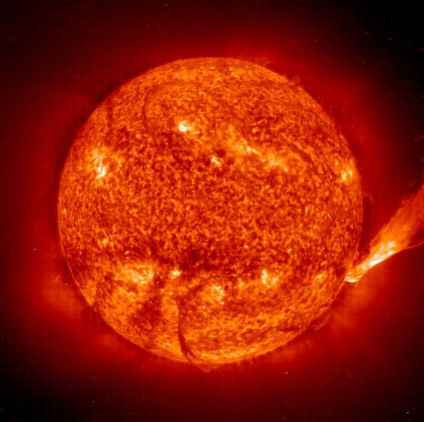
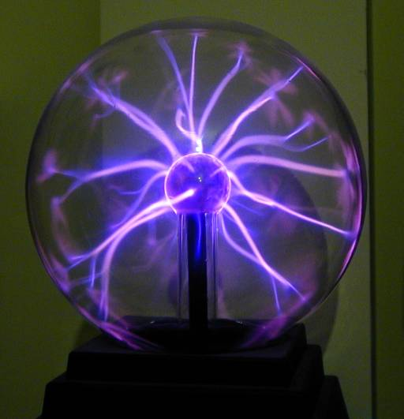
PLASMA
Consists of + and – particles
Ex. Sun, lighting

Slide 9
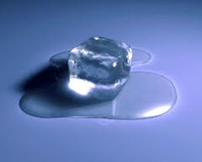
CHANGING STATES OF MATTER
Melting

Slide 10
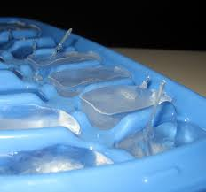
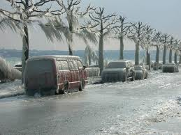
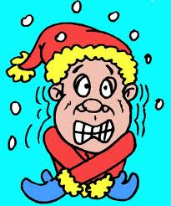
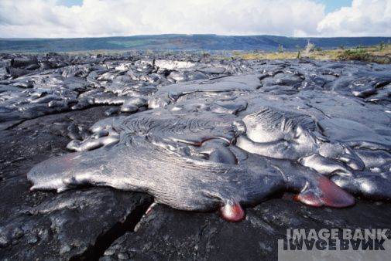
CHANGING STATES OF MATTER
Freezing

Slide 11
HEAT OF FUSION
Heat of fusion: amount of energy needed to change a substance from a solid to a liquid

Slide 12
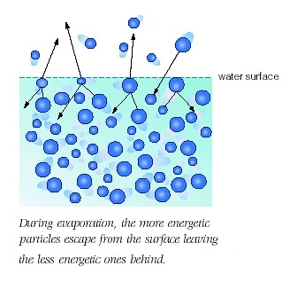
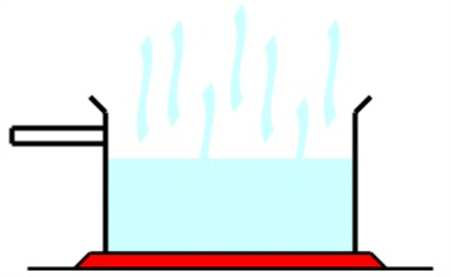
CHANGING STATES OF MATTER
Evaporation

Slide 13
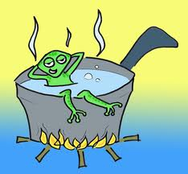
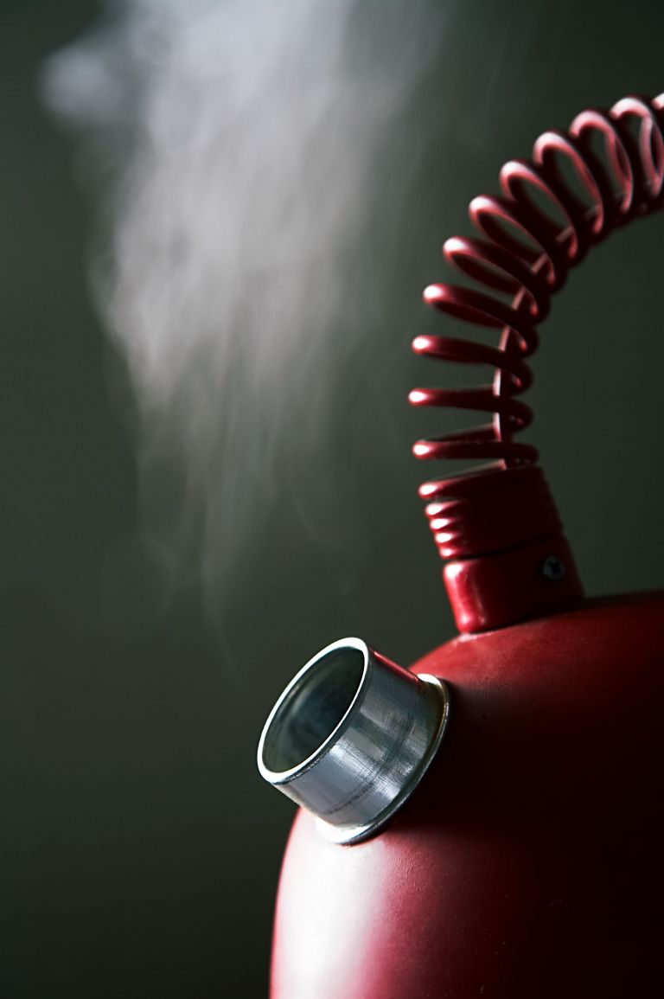
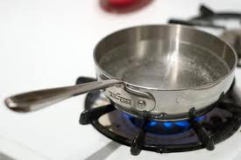
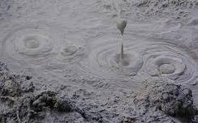
CHANGING STATES OF MATTER
Boiling

Slide 14
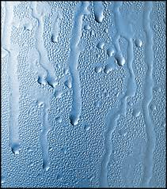
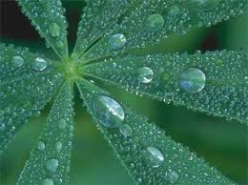
CHANGING STATES OF MATTER
Condensation

Slide 15
HEAT OF VAPORIZTION
Amount of energy required to change a liquid to a gas or a gas to a liquid

Slide 16
Heating and Cooling Curves
Read the article
Discuss article
Diagram of heating and cooling curve
Discuss lab
Answer questions

Slide 17
Activity
Materials
Pipet
Rubbing alcohol
Human hand

Slide 18
Procedure
Use a pipet to place 5 drops of rubbing alcohol on the back of your hand.
Wait for two minutes
What sensation did you feel?

Slide 19
Analysis
1. What change of state did you observe?
2. Is energy entering or leaving your hand?
3. Where does the energy for this process come from?
4. Is this an example of heat of vaporization of heat of fusion?
5. What is the function of perspiration during hot weather and exercise?

Slide 20
Video Clips
http://www.youtube.com/watch?v=j2KZmRIKea8

