Slide 1
Plan for Today (AP Physics 1)
Test results
New Unit – motion in 2 Dimensions
Notes on adding vectors graphically
Homework: Ch 3.1 due Friday

Slide 2
Test Results (General)
82% Average
15 As, 15 Bs,

Slide 3
Previous Years
2012– average around a 76
2011 – average around 82

Slide 4
Vector Basics

Slide 5
Vector Basics

Slide 6
Vector Basics
Which vector is bigger?
How do you know?

Slide 7
Vector Basics

Slide 8
Vector Basics
What is different?
How can we name these?

Slide 9
Vector Basics

Slide 10
Vector Basics
How would you name this?

Slide 11
Vector Basics

Slide 12
Vector Basics
What about these 2?
How are they different?

Slide 13
Vector Review – Vectors and Scalars
Scalar – a physical quantity that has magnitude but no direction
Ex – speed, volume, number of pages in a book
Vector - a physical quantity that has both magnitude and direction
Ex – displacement, velocity, acceleration

Slide 14
Vector Basics
We need to include length and direction for our vectors

Slide 15
Vector Basics - Writing

Slide 16
Vector Basics - Writing
3 m at 20 degrees North of East
OR
3 m at 70 degrees East of North

Slide 17
Naming Vectors - Examples

Slide 18
Vector Review
Resultant vector – represents the sum of two or more vectors

Slide 19
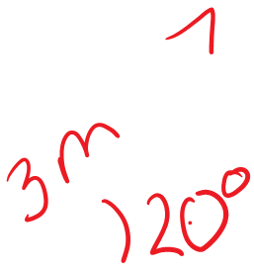
Properties of Vectors
Vectors can be moved parallel to themselves in a diagram

Slide 20
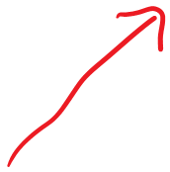
Properties of Vectors
Vectors can be added in any order

Slide 21
Example Problem
A paper airplane moves at a constant velocity of 10 m/s. What is its resultant velocity if it moves with a parallel wind gust of 19 m/s?
10 + 19
29 m/s forward

Slide 22
Example Problem
A stunt man tries to run backward on a treadmill. The stuntman’s constant velocity is 8 m/s and the treadmill is moving at a velocity of 9 m/s. What is the resultant velocity?
9 - 8
1 m/s forward on the treadmill

Slide 23
Example
If you walk 5 m east, 7 m north, then 8 m east, what is your displacement from the origin?
When solving these, draw to scale

Slide 25
Make it tougher
What if you travel 7 m at 20 degrees North of East
Then 10 m at 50 degrees S of E
Then 12 M at 80 degrees N of W
What is your resultant (distance from the origin)?

Slide 27
Rules for Graphical Vector Addition
1. Set a convenient scale
2. Draw the first vector to scale
3. Attach the tail of the second vector to the tip of the first
4. Repeat
5. The RESULTANT starts at the tail of the first and ends at the tip of the last
6. Measure length and angle of resultant.

Slide 28
Resultant
Always measure the angle of the resultant from an axis (nothing crazy or sideways)

Slide 29
Properties of Vectors
To subtract a vector, add its opposite

Slide 30
Properties of Vectors
Multiplying or dividing vectors by scalars results in vectors

Slide 31
Vector PHET

Slide 32
Assignment
Graphical Worksheet

