Slide 2
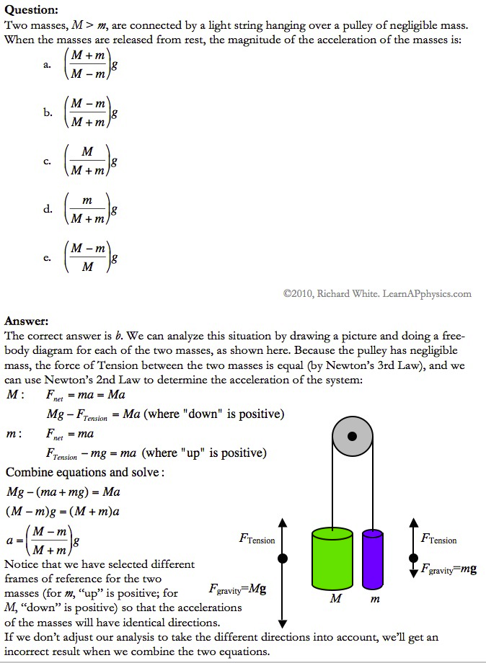

Slide 3
Plan for Today (AP Physics 2)
Demonstrations, questions, and lecture on fluids

Slide 4
Equation for Density
P = m/V
V = volume
P = rho = density
See table 9.3 on p. 262 for common densities

Slide 5
How does pressure change as we get deeper inside a substance?
Diagram

Slide 6
How does pressure change as we get deeper inside a substance?
What is the pressure at the bottom of the tank?
Pressure is force per unit area
Force applied by water on the bottom of the tank
Must just be the weight of the water mg
But for fluids, we don’t usually talk about their mass, but their density, p

Slide 7
How does pressure change as we get deeper inside a substance?
So if we use density and solve for mass
p= m/V
m = pV
Weight of the water is pVg
Pressure = P = F/A
P = pVg/A

Slide 8
How does pressure change as we get deeper inside a substance?
P = pVg/A
Volume/Area
V/A = h = height of fluid
Pressure due to the column of water
P = pgh

Slide 9
How does pressure change as we get deeper inside a substance?
P = pgh
This is the pressure from the column of water
But we have a problem – the pressure at the top isn’t 0
So the total pressure is the pressure at the top (P0) plus the pressure from the liquid
P = P0 + pgh
What is P0?
Air pressure

Slide 10
How does pressure change as we get deeper inside a substance?
Let’s calculate it and then check
P = P0 + pgh
P0 = 1.013 * 10^5 Pa
P is density of water
Denisty of water = 1000 kg/m^3
Should get around 103 kPa

Slide 11
What if we were about halfway down?
What would we expect?
Pressure around 101 or 102 Pa

Slide 12
Gauge Pressure vs. Absolute Pressure
Gauge pressure
Pressure caused by fluid only
Difference from atmospheric or “base” pressure
Pgh = P – P0
Absolute pressure
What we calculated
P = P0 + pgh

Slide 13
Things to note
Pressure in a liquid is the same at all points having the same elevation
Shape does not affect the pressure

Slide 14
Playing with straws
When you put your finger on the top of the straw to lift some drink out. . .
For the air inside the straw, above the fluid but below your finger, what is that air pressure
Greater than atmospheric pressure?
Less than atmospheric pressure?
Equal to atmospheric pressure
Think about the answer

Slide 15
Playing with straws
Answer: Less than atmospheric
Consider the equation: P = P0 + pgh
Here, P0 is the pressure at the top of the fluid column, P is the pressure at the bottom
P (pressure at the bottom) is atmospheric pressure
Why?
Because any time a liquid is exposed to the atmosphere, you consider it to be at atmospheric pressure
So P0 = P - pgh
Pressure at the top is atmospheric pressure minus something

Slide 16
Playing with Straws (Ideal Gas Law)
Liquid drops down a little bit before settling
Means air under your finger expanded a little
Temperature didn’t change, no air escaped
PV = nRT
Increased volume means reduced pressure

Slide 17
How do straws work general
When the straw is just sitting in the glass, the pressure on the liquid is the same all over, including the part inside the straw
When you suck air out of the straw, you decrease the pressure inside the straw
This allows the higher pressure on the rest of the surface to push the liquid up
It is really the atmosphere doing the pushing
So atmospheric pressure limits how high water will go

Slide 18
Long Straw Demo

Slide 19
Suction Cups
Work by forcing an airtight seal against a surface
When we press against the wall, suction cups deform in shape
Pocket of air forms between the cup and surface – but it’s not in the natural shape of the cup – and the cup wants to restore its shape
To do this, it increases the size of the air pocket, but no air can get in – so gas has more volume and less pressure than outside
Air pressure outside pushes suction cup stronger than from inside – net force pushing it against the surface
Then the air inside has low air pressure, the outside is regular air pressure
So we have suction

Slide 20
Suction Cup Diagram

Slide 21
Manometer
U-shaped tube
One end is open to the atmosphere
Other end connected to system of unknown pressure

Slide 22
Manometer Diagram
Pressure at point B is
P = P0 + pgh
Pressure at A is the same

Slide 23
Barometer
Tube closed at one end is filled with mercury and put on a dish of mercury

Slide 24
Barometer
Question:
Why doesn’t all the mercury run out?
Because the atmosphere is pushing down

Slide 25
Barometer
Question:
Why doesn’t all the mercury run out?
Because the atmosphere is pushing down

Slide 26
Barometer
In space the mercury would all flow out
We sometimes measure pressure in mm of Hg

Slide 27
Barometer
Pressure at the bottom of the column
Pbottom = Ptop + pgh
Ptop = 0 (because it’s a vacuum)
Pbottom = pgh = Patm
Note:
p is for mercurcy
h = Patm/(pg)
p of mercury is 1.3595 * 10^4 kg/m^3
Patm = 1.013 * 10^5 Pa
h = 0.760 m

Slide 28
Why don’t we have water barometers?
h = Patm/(pg)
Patm = 1.013 * 10^5Pa
p = 1.00 * 10^3
h = 10 m
Hmm, that seems like a lot

Slide 29
Diagram of Manometer

Slide 30
How much less do objects weigh (or appear to weigh) in water?
If we have a 200 g mass hanging from a force probe
The force probe now reads. . . About 2.0 N
What will the force probe read when we completely submerge the mass in water?

Slide 31
How much less do objects weigh in water?
Set up

Slide 32
How much less do objects weigh in water?
Think of a cylinder of base area A in a fluid
The fluid has density p
The top of the cylinder is at a depth h1 and the bottom is at h2

Slide 33
How much less do objects weigh in water?
Water applies pressure to the cylinder inward in all directions
The pressure on the sides will cancel – so only the top and bottom matter
Water pushes down on the top face of the cylinder
Pushes up on the bottom face

Slide 34
How much less do objects weigh in water?
F = P * A
Total force applied by water is difference between force on top and force on bottom

Slide 35
How much less do objects weigh in water?
What is the force on the top?
Ftop = Ptop * A
Ftop = (P0 + pgh1) * A
What is the force on the bottom?
Fbottom = Pbottom * A
Fbottom = (P0 + pgh2) * A

Slide 36
How much less do objects weigh in water?
Force applied by water is the buoyant force
Fbuoy = Fbottom – Ftop
Fbuoy = [(P0 + pgh2)*A – (P0 + pgh1)*A]
Fbuoy = pgA(h2 – h1)
Fbuoy = pg * V
Note: p is the density of the fluid
V is the volume of the submerged object

Slide 37
How much less do objects weigh in water?
Free body diagram for a fully submerged mass
Fully submerged mass in equilibrium
Fbuoy + T = mg
T = mg - pg * V
We have water so p = ?
1000 kg/m^3
What about the volume?
Let’s measure by displacing fluid in graduated cylinder

Slide 38
How much less do objects weigh in water?
What do we calculate the T will be (the apparent weight)?
Let’s check it

Slide 39
Buoyant Force
Diagram

Slide 40
Buoyant Force
Let’s look at the forces acting on the cube
We have forces from the fluid acting on each side of the cube
BUT those forces cancel
We also have forces acting on the top and bottom of the cube
And those don’t cancel because they are different values

Slide 41
Buoyant Force
Remember: P = F/A
So F = P * A
Force on the top
F1 = P1A1
F1 = P1 * L^2
Forces on the bottom
F2 = P2A2
F2 = P2 * L^2

Slide 42
Buoyant Force
P2 = P1 + pgh
P2 = P1 + pg L
F = P * A
So F2 = . . .
F2 = P1*L^2 + pgL * L^2
F2 = F1 + pgL^3
F2 = F1 + pg * V
Note: p is the density of the fluid
V is the submerged volume of the object

Slide 43
Buoyant Force
F2 = F1 + pg * V
Fb = F2 – F1 = pg * V
Buoyant Force
B = wfluid = pg * V

Slide 44
Things to note about Buoyancy
Buoyant force is caused by the pressure difference between the top and bottom of the object
Acts vertically upward

