Slide 1
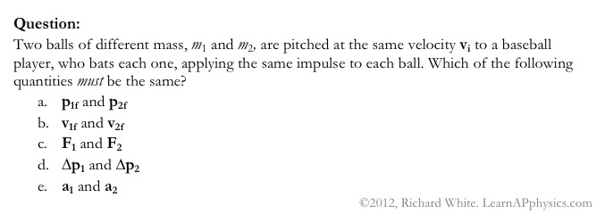

Slide 2
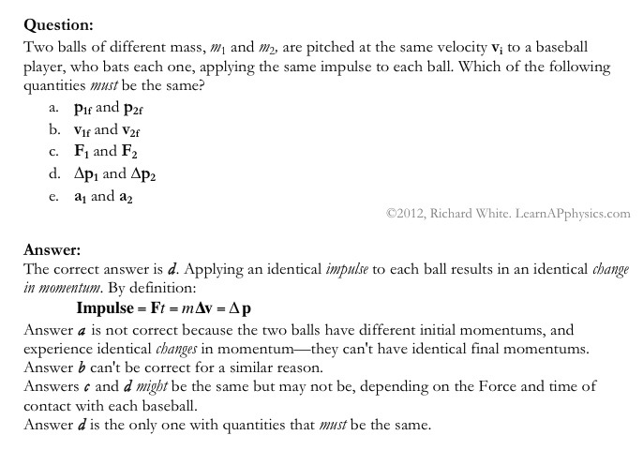

Slide 3
Plan for Today (AP Physics 2)
Tests back
Website/Flipped
Discuss Buoyancy
Time to work on homework (you can do the first 5)

Slide 4
How much less do objects weigh (or appear to weigh) in water?
If we have a 200 g mass hanging from a force probe
The force probe now reads. . . About 2.0 N
What will the force probe read when we completely submerge the mass in water?

Slide 5
How much less do objects weigh in water?
Set up

Slide 6
How much less do objects weigh in water?
Think of a cylinder of base area A in a fluid
The fluid has density p
The top of the cylinder is at a depth h1 and the bottom is at h2

Slide 7
How much less do objects weigh in water?
Water applies pressure to the cylinder inward in all directions
The pressure on the sides will cancel – so only the top and bottom matter
Water pushes down on the top face of the cylinder
Pushes up on the bottom face

Slide 8
How much less do objects weigh in water?
F = P * A
Total force applied by water is difference between force on top and force on bottom

Slide 9
How much less do objects weigh in water?
What is the force on the top?
Ftop = Ptop * A
Ftop = (P0 + pgh1) * A
What is the force on the bottom?
Fbottom = Pbottom * A
Fbottom = (P0 + pgh2) * A

Slide 10
How much less do objects weigh in water?
Force applied by water is the buoyant force
Fbuoy = Fbottom – Ftop
Fbuoy = [(P0 + pgh2)*A – (P0 + pgh1)*A]
Fbuoy = pgA(h2 – h1)
Fbuoy = pg * V
Note: p is the density of the fluid
V is the volume of the submerged object

Slide 11
How much less do objects weigh in water?
Free body diagram for a fully submerged mass
Fully submerged mass in equilibrium
Fbuoy + T = mg
T = mg - pg * V
We have water so p = ?
1000 kg/m^3
What about the volume?
Let’s measure by displacing fluid in graduated cylinder

Slide 12
How much less do objects weigh in water?
What do we calculate the T will be (the apparent weight)?
Let’s check it

Slide 13
The buoyant force on an object is equal to the weight of the fluid the object displaces

Slide 14
Question
A student stands on the bottom of a deep swimming pool. He drops a bowling ball with specific gravity 5.0 from a height of 1.0 m above the bottom of the pool. How much time does it take for the bowling ball to hit the bottom?
A - 0.005 s
B - 0.02 s
C- 0.5 s
D- 2.0 s
E - 5.0 s

Slide 15
Question
A student stands on the bottom of a deep swimming pool. He drops a bowling ball with specific gravity 5.0 from a height of 1.0 m above the bottom of the pool. How much time does it take for the bowling ball to hit the bottom?
FBD shows buoyant force upward and mg downward
Use Newton’s second law
Fnet = Fg – Fb
Mg – Fbuoyant = ma

Slide 16
Continued
Mg – Fbuoyant = ma
Buoyant force is pwater * Vball * g since the ball is completely submerged
Mass of ball is the same as pball * Vball
pball * Vball * g - pwater * Vball * g = pball * Vball * a
Volumes cancel
pball * g - pwater * g = pball * a
A = (pball*g - pwater * g)/ pball
(5 * 9.8 – 1 * 9.8)/5
= 8.0 m/s/s

Slide 17
Vi = 0
A = 8.0 m/s/s
t = ?
X = vi * t + ½ a * t^2
t = Sqrt (2 * x/a)
= sqrt (2 * 1/8)
= sqrt (1/4)
= 1/2

Slide 18
That’s a lot of work
Intuitively, we can drop the ball from half our height in less than 2 seconds, but it is measurable so it must be more than 0.002

Slide 19
Remainder of Class
Time to work on homework

