Slide 1
Plan for Today (AP Physics 2)
Wrap Up Buoyancy
Discuss Pascal’s Principle
AP Question

Slide 2
Recap with Buoyancy
We got that B= pfluid * V *g or the weight of the fluid displaced
This is always true
But the way we go about calculating it for floating and submerged objects is a little different

Slide 3
Archimedes Principle
“Any object completely or partially submerged in a fluid is buoyed up by a force whose magnitude is equal to the weight of the fluid displaced by the object”
Buoyant force = weight of the fluid

Slide 4
Totally submerged object
B = pfluid * Vobject * g
Net force is:
B – w = (pfluid – pobject) * Vobject * g
If the density of the object is less than the fluid, the object (if unsupported)

Slide 5
Floating Object
Buoyant force is balanced by force of gravity
Vfluid = volume of fluid displaced by the object = volume of object beneath the fluid
Buoyant force
B = pfluid * Vfluid * g
Weight of the object = w = m*g = pobject * V object *g
W = B
Pfluid * Vfluid * g = pobject * Vobject * g
Pobject/ pfluid = Vfluid/Vobj

Slide 6
Back to manometer
What do you think will happen?
It will eventually all go to one level
Somewhere between the first two

Slide 7
What if we had two fluids?
Pressure at the bottom = Pressure at the top + pgh
The heights are different because p is different

Slide 8
What if we had two fluids?
Pressure at the bottom = Pressure at the top + pgh
The heights are different because p is different

Slide 9
What if we had two fluids?
Pressure at the bottom = Pressure at the top + pgh
The heights are different because p is different

Slide 10
What if we had two fluids?
Pressure at the bottom = Pressure at the top + pgh
The heights are different because p is different

Slide 11
Fun with syringes

Slide 12
Pascal’s Principle
A change in pressure applied to an enclosed fluid is transmitted undiminished to every point of the fluid and to the walls of the container

Slide 13
Pascal’s Principle Restated
If you increase the pressure at the top of a fluid, you will increase the pressure everywhere
In fact, you will increase pressure everywhere by the same amount

Slide 14
How can we lift a car?
Animation

Slide 15
How can we lift a car?
Diagram

Slide 16
How can we lift a car?
Set up for a hydraulic lift
A1 is much smaller than A2
We have an incompressible fluid between our two pistons

Slide 17
How can we lift a car?
Incompressible fluid means than volume must be conserved
So change in volume on one side = change in volume on the other side

Slide 18
How can we lift a car?
Incompressible fluid means than volume must be conserved
So change in volume on one side = change in volume on the other side

Slide 19
How can we lift a car?
Incompressible fluid means than volume must be conserved
So change in volume on one side = change in volume on the other side

Slide 20
How can we lift a car?
Incompressible fluid means than volume must be conserved
So change in volume on one side = change in volume on the other side

Slide 21
How can we lift a car?
Incompressible fluid means than volume must be conserved
So change in volume on one side = change in volume on the other side
The distance on d1 is going to be much greater than the distance of d2

Slide 22
How can we lift a car?
Pressures must be the same (by Pascal’s principle)
P1 = P2
F1/A1 = F2/A2

Slide 23
How can we lift a car?
Pressures must be the same (by Pascal’s principle)
P1 = P2
F1/A1 = F2/A2

Slide 24
How can we lift a car?
Pressures must be the same (by Pascal’s principle)
P1 = P2
F1/A1 = F2/A2

Slide 25
How can we lift a car?
Pressures must be the same (by Pascal’s principle)
P1 = P2
F1/A1 = F2/A2

Slide 26
How can we lift a car?
Pressures must be the same (by Pascal’s principle)
P1 = P2
F1/A1 = F2/A2

Slide 27
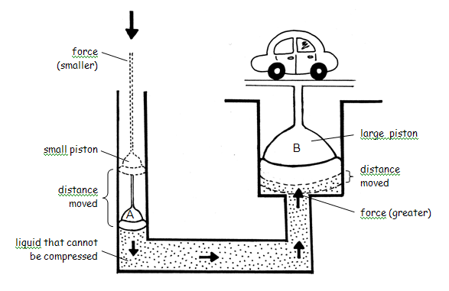

Slide 28
