Slide 1
Get out your reading guide but DO NOT turn it in
Go over reading guide
Gravity Notes
Weight and Mass Calculations
Homework: Weight Worksheet
What is gravity?
Agenda
AQOD

Slide 2
Gravity

Slide 3
Gravity
What is it?

Slide 4
Gravity
Gravity is the attractive force between any two objects that have mass.
depends on the masses of the objects and the distance between them.
Increases as mass increases or as the objects get closer.

Slide 5
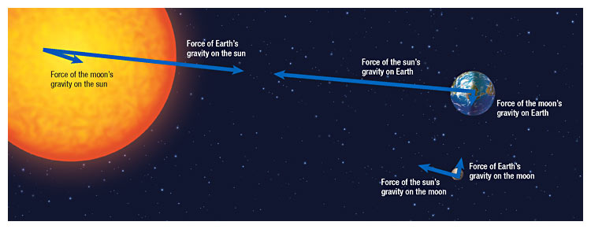

Slide 6
Gravity
depends on
the masses of the objects
the distance between them.
Increases as mass increases or as the objects get closer.

Slide 7
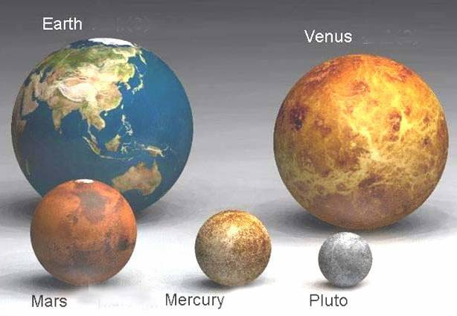

Slide 8
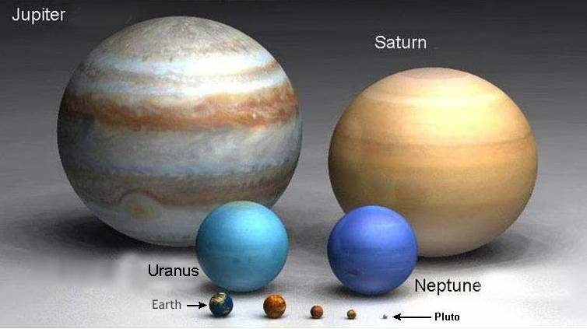

Slide 9
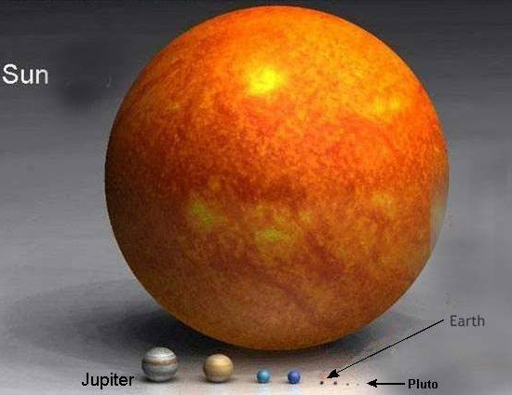

Slide 10
Earth’s gravitational acceleration
If you dropped a book and a piece of paper at the same time which would hit the ground first?
Take out air resistance. Now what?

Slide 11
Acceleration on earth due to gravity
Force of gravity on a falling object can be calculated with 2nd law equation
F_{g} = weight = mg
g = 9.8 m/s² (On earth)
What about on Jupiter?

Slide 12
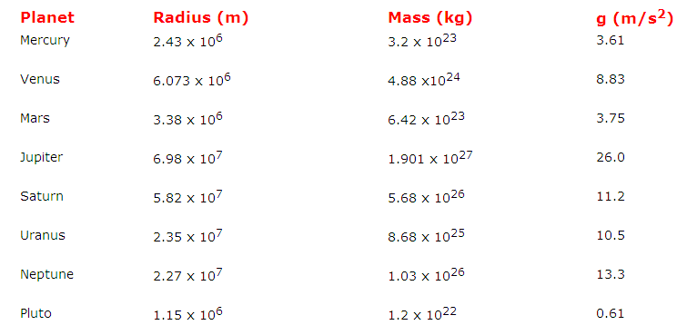
Gravity on other planets

Slide 14
Mass vs Weight
The amount of matter an object contains
Will NOT change if you visit another planet
Measured in kg
Gravitational force exerted on an object
Will change if you visit another planet, because the acceleration due to gravity changes
Measured in N
MASS
WEIGHT

Slide 15
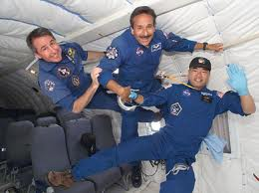
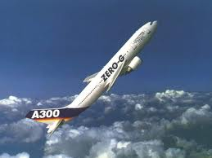
Weightlessness & Free Fall
Parabolic Dive Video

Slide 16
“Weightlessness” on the Space Shuttle…
Objects seem weightless (float around) on the space shuttle because they are in orbit with the space shuttle.
In other words, objects are in free fall…falling AROUND the Earth rather than downward toward it.

