Slide 2
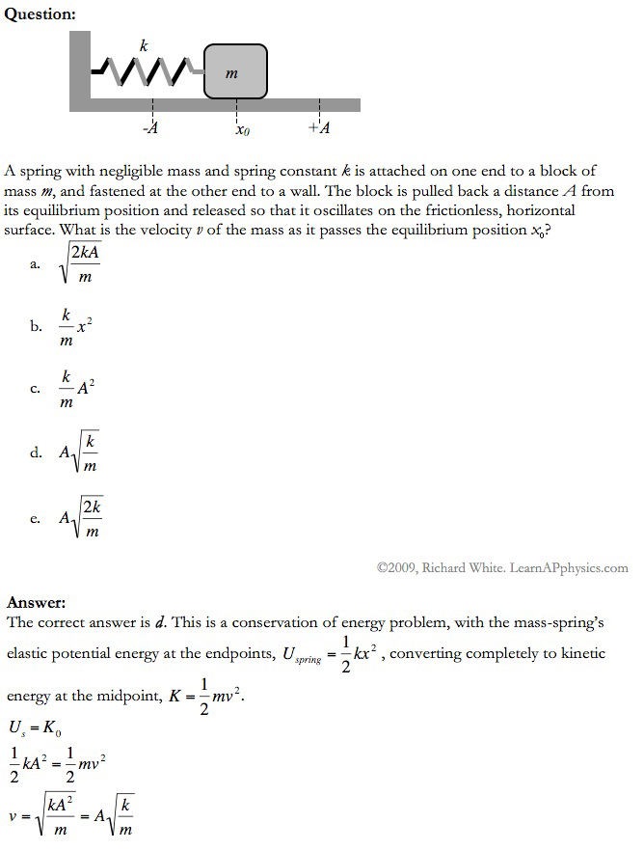

Slide 3
Plan for Today (AP Physics 2)
Go over review page
Go over conceptual questions
Go over multiple choice
Any questions

Slide 4
Understand the following demonstrations
Expect to see some of these as a qualitative type question
How a straw works
Create low pressure on top, because of atmospheric pressure in the fluid in the glass it forces the fluid to rise up
How a hot air balloon works
Heats air inside – hot air is less dense and rises up (buoyant force)
How an atomizer works
Blows low pressure air over a column of fluid, causes column of fluid to rise and particles to be dispersed

Slide 5
Understand the following demonstrations
Expect to see some of these as a qualitative type question
Why a Frisbee flies longer than a ball dropped at the same time (FBD)
Has lift or buoyant force from the shape
So acceleration less
How a hydraulic jack works and why conservation of energy is not violated
Get more force out but put more force in
So conservation of energy not violated (work is the same)
The difference between gauge and absolute pressure
Gague P = Abs P – Atm P

Slide 6
Calculate the pressure at any point in a static liquid
P = P0+ pgh
Be able to differentiate if a problem is asking for gauge pressure or absolute pressure

Slide 7
Understand and apply Pascal’s law
States: when pressure is applied to an enclosed fluid, the pressure is transmitted undiminished to every point of the fluid and to the walls of the containing vessel
What this means: this is how a hydraulic jack works
P = F/A
Large force requires large area
W = F * d
Large force small distance, small force large distance
Expect to see a hydraulic type problem

Slide 8
Apply buoyancy – to find volume and for floating objects
Like our lab we did
Be able to figure out buoyant force, volume, and density from similar information
Weight – Weight in water (fluid) = Buoyant force
Volume
Buoyant force = density of fluid * 9.8 * volume for fully submerged
Density
Mass /volume

Slide 9
Apply buoyancy – to find volume and for floating objects
For floating objects
Buoyant force = weight
Weight = mg for object (or pVg if given volume and density of object)
Buoyant force = density of fluid * g * Volume of object submerged
Be sure to use volume of object submerged
Be able to figure out how much of a floating object would be submerged

Slide 10
Apply conservation of mass to flowing liquids
Equation of continuity
A1v1 = A2V2
Volume flow rate (A*v) stays constant
Be able to figure out volume flow rate given volume and time
Be able to figure out velocity given area and volume flow rate
Compare one part of a pipe/tube to another

Slide 11
Apply Bernoulli’s equations
P1 + ½ pv1^2 + pgh1 = P2 + ½ p v2^2 + pgh2
Hopefully things cancel
Torcelli’s law to shorten things
Expect to see a problem where you have to fully apply Bernoulli’s
Expect to see a leaking bucket

