Slide 2
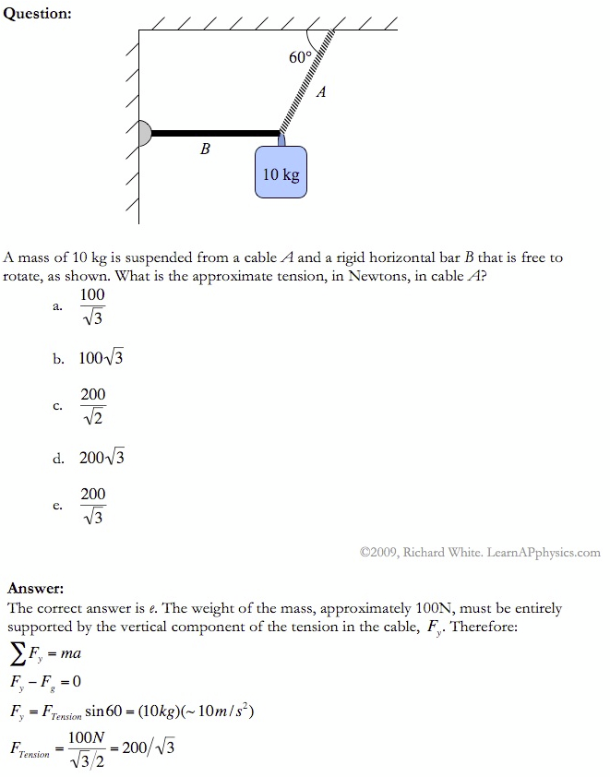

Slide 3
Plan for Today (AP Physics I)
Notes/Lecture on Rotational Motion

Slide 4
Question 1
Describe the motion of a ball spun on a string in terms of displacement, distance, velocity, speed, and acceleration
Speed – constant, not changing
What about velocity
Displacement – from linear view always returns to zero
So how can we calculate this?
Acceleration – constant speed so no acceleration?
But v is always changing so how do we have this?
Because rotation is so different, we need to look at a different way of measuring
2 types of acceleration
Linear AND rotational

Slide 5
Question 2
Describes what happens when I let the ball go at points A and B
What does the string provide?
A force to cause the rotation/acceleration
Motion is linear without the string

Slide 6
Question 3
Describe the similarities and differences in the motion of the two dots on the record
As they spin, are linear displacement and velocity the same?
No
How do we set up a coordinate system so the dots have the same motion?

Slide 7
Question 4 (Calculation)
A wheel starts from rest and turns through 56 radians at an angular acceleration of 3.5 rad/s^2. What is
The time required
The final angular velocity in rad/sec

Slide 8
Answers
T = 5.7 seconds
Wf = 19.8 rad/s

Slide 9
Rotational Motion
Zero-point is the positive x axis
Positive is counterclockwise (same as math)

Slide 10
Displacement
= radians or revolutions or degrees
Conversions
2 pi rad = 360 degrees = 1 revolution
In this class, I want your answer to NOT have pi in it (give me a rounded number)
Look at the units to solve (whether you are in radians vs degrees vs revolutions)

Slide 11
What is one radian?
Diagram
What is it?
S = r * O
O = s/r
1 = 1
S = r at O = 1 radian

Slide 12
How do we convert radial to linear?
We have this occur, right?
Record spinning then sliding across floor
So we need a way to look at linear vs. angular

