Slide 1
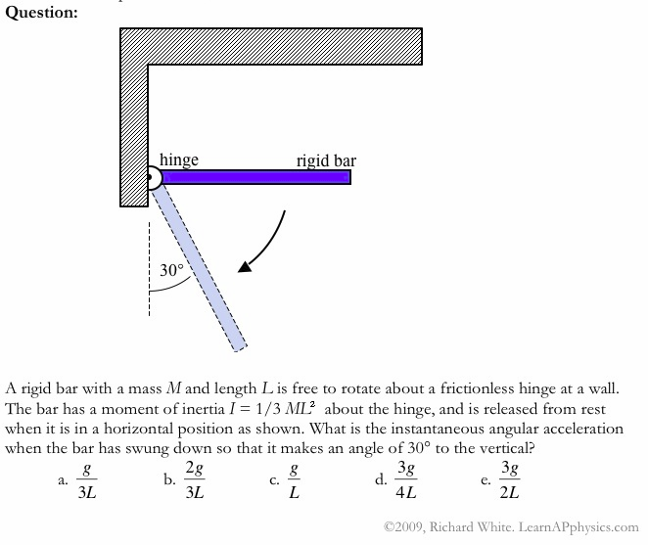

Slide 2
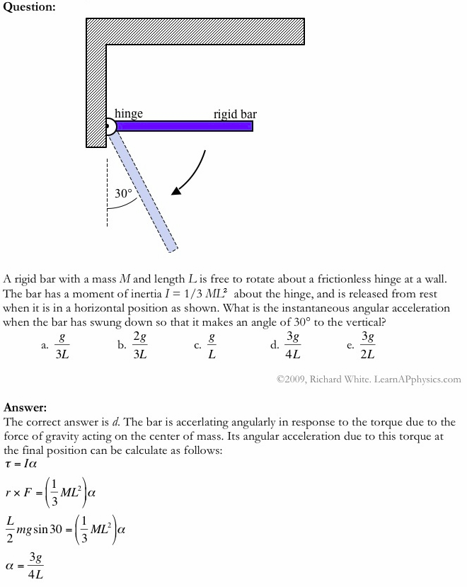

Slide 3
Plan for Today (AP Physics 2)
Review
Quiz on Friday on Lenses and Mirrors
Final (Released AP Problems, MOP)

Slide 4
Mirrors and Lenses – what to study

Slide 5
Snell’s Law and Last Year Stuff
Be able to apply snell’s law (MC type question)
What happens when light changes mediums
Refraction – when is the angle bigger or smaller
Frequency – stays same
Speed – decreases for bigger n
Wavelength (v = f * h – also decrease)

Slide 6
Mirrors
Plane mirrors from last year
Image is virtual, same size, upright
But R and L are reversed

Slide 7
Mirrors - Concave
When is the object real vs virtual
What does real/virtual mean
How to calculate size
General patterns for at focal point, beyond, at C, beyond C, etc

Slide 8
Mirrors - Convex
Image is virtual
Focal length is negative (in the mirror) as is di – be careful with signs when using mirror equation

Slide 9
Lenses - Convex
Like concave mirrors
When are images real vs virtual
How to use lens equation (now where are f and di positive

Slide 10
Concave lenses
Figuring out from series (like lab)

Slide 11
Test format
Multiple choice - 10
Short answer - 2 - like AP type problems
Study AP problems, videos and you should be fine

Slide 12
Final Format
7 released AP Problems
Topics –
Electricity and magnetism
Fluids
Thermodynamics
Light
This is paced like the AP would be
I will use a modified AP curve (you guys should do better than a national average since we’ve been studying these topics)

Slide 13
Final Studying Advice
Look over previous AP problems we have done in class
Look at additional AP problems
Look up additional AP problems online
Trying “mopping” or watching videos or looking at links on my website to refresh your memory of concepts

